Slide 1
Exception Handling: A Deeper Look
Chapter 13 of Visual C# How to Program, 6/e

Slide 2
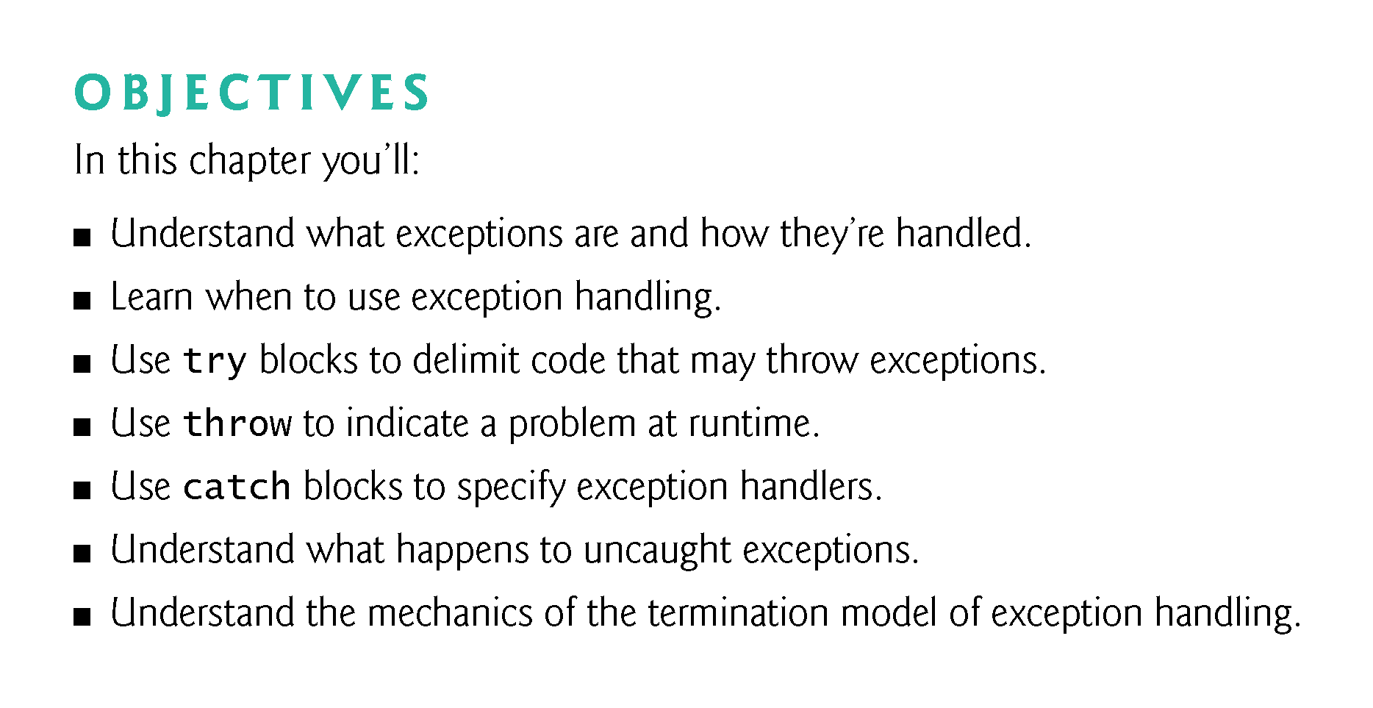
Notes:
Delimit
划界
Huà jiè
划界
Huà jiè
Mechanics
力学
Lìxué

Slide 3
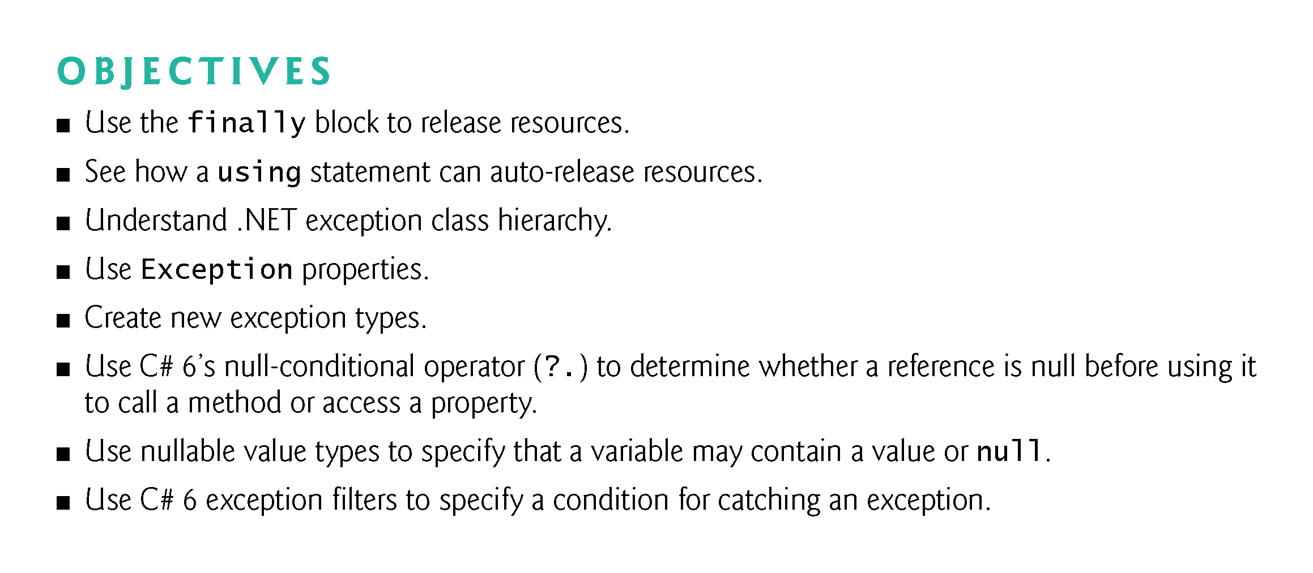

Slide 4
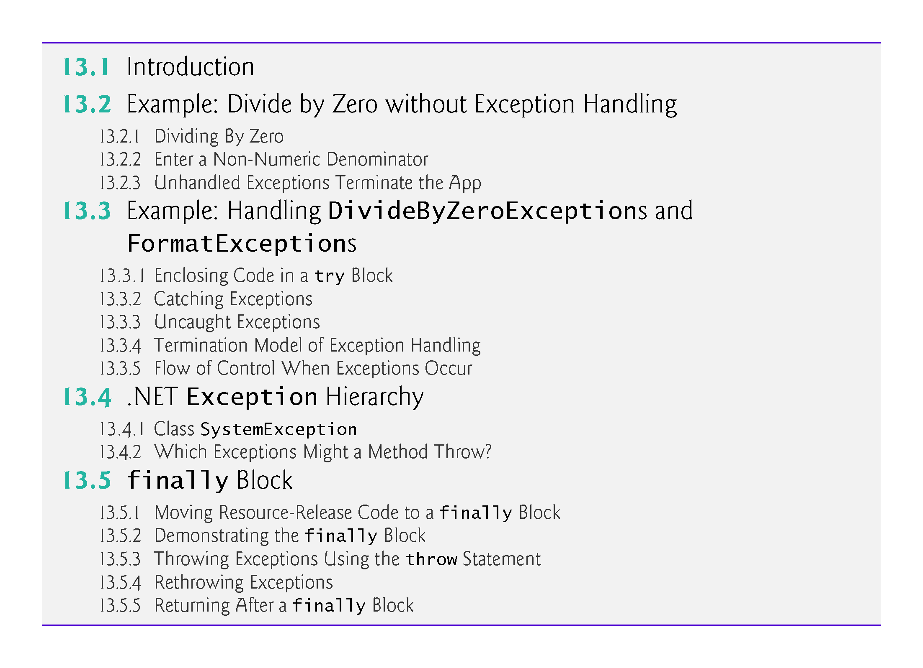

Slide 5
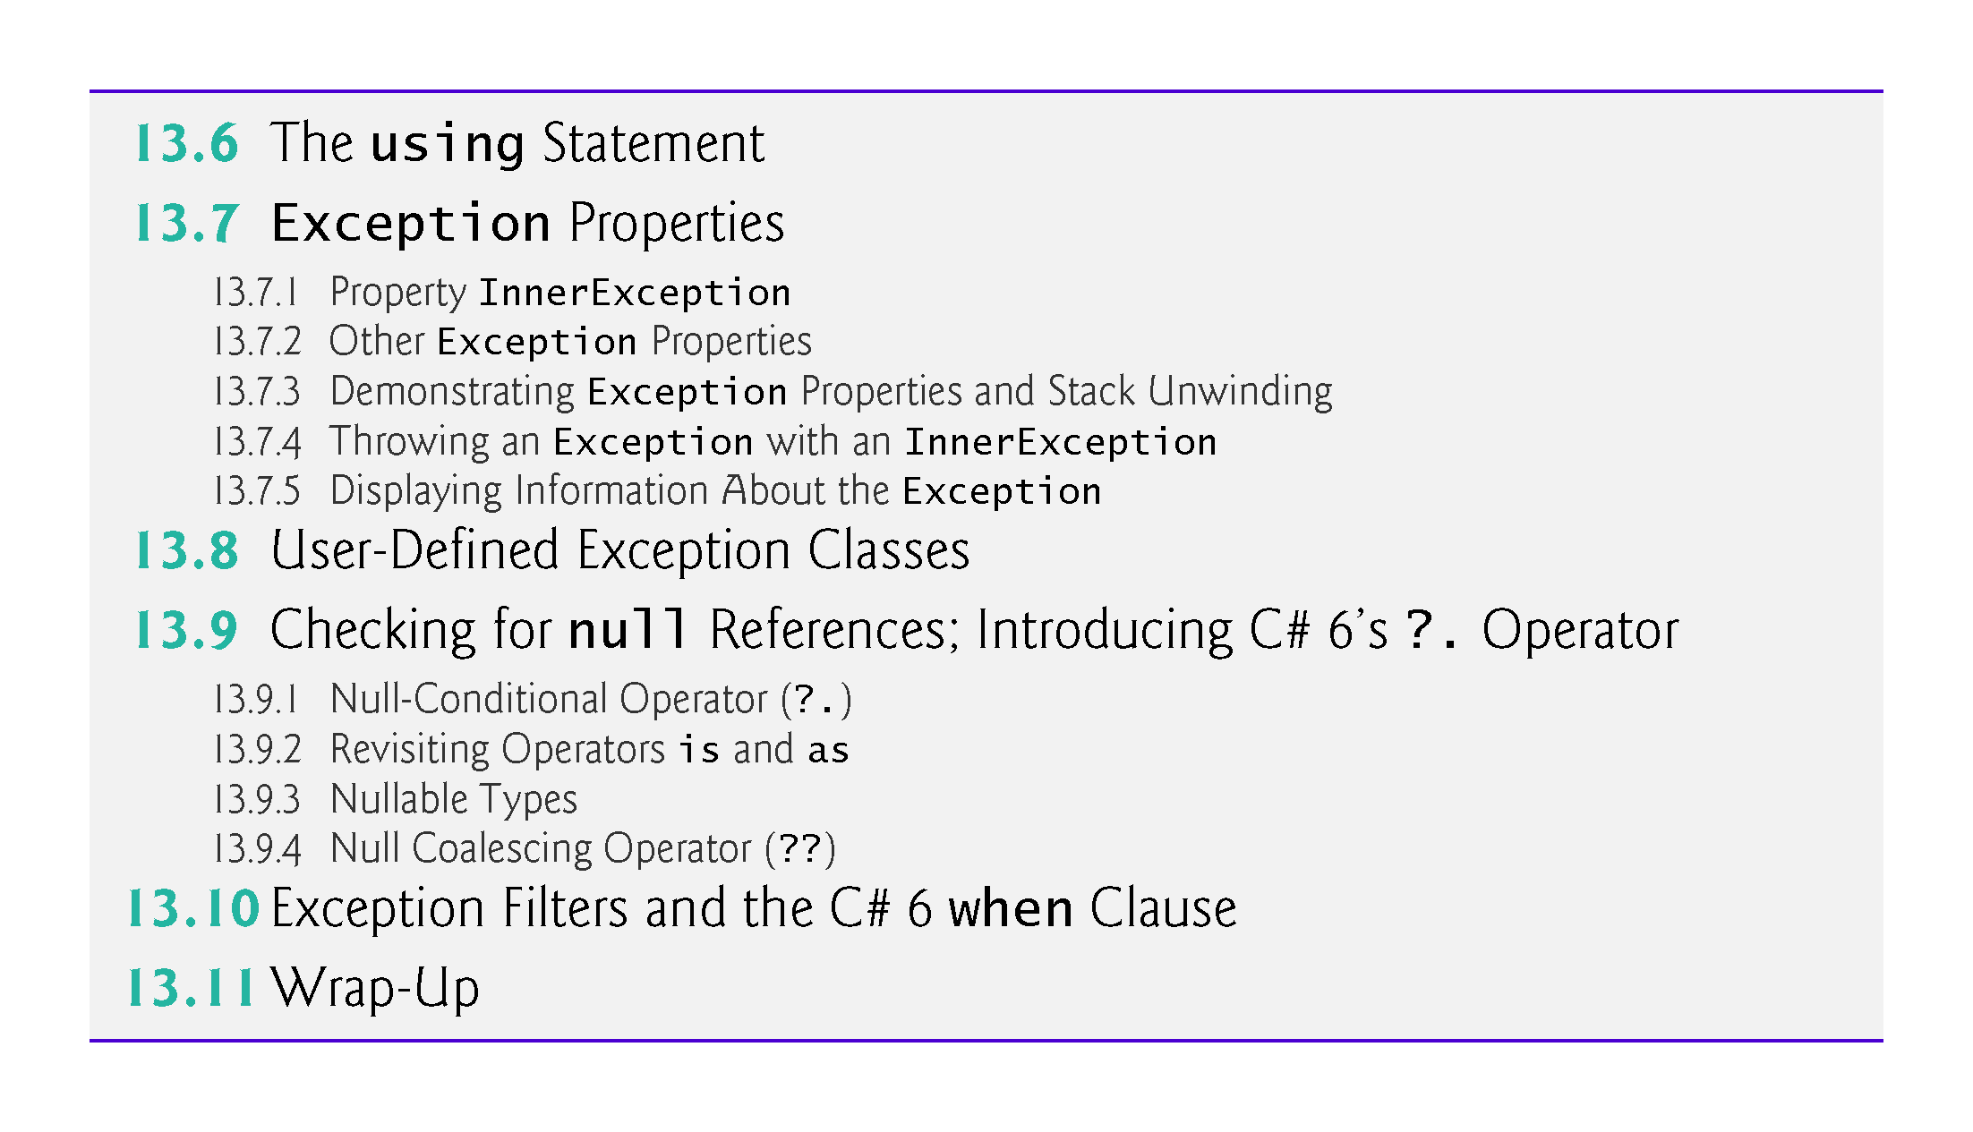

Slide 6
13.1 Introduction
An exception is an indication of a problem that occurred during a program’s execution.
Exception handling enables you to create apps that can handle exceptions—in many cases allowing a program to continue executing as if no problems were encountered.
Exception handling enables you to write clear, robust and more fault-tolerant programs.

Slide 7
13.2 Example: Divide by Zero without Exception Handling
Figure 13.1’s inputs two integers from the users, then divides the first integer by the second using integer division to obtain an int result.
In this example, an exception is thrown (i.e., an exception occurs) when a method detects a problem.

Slide 8
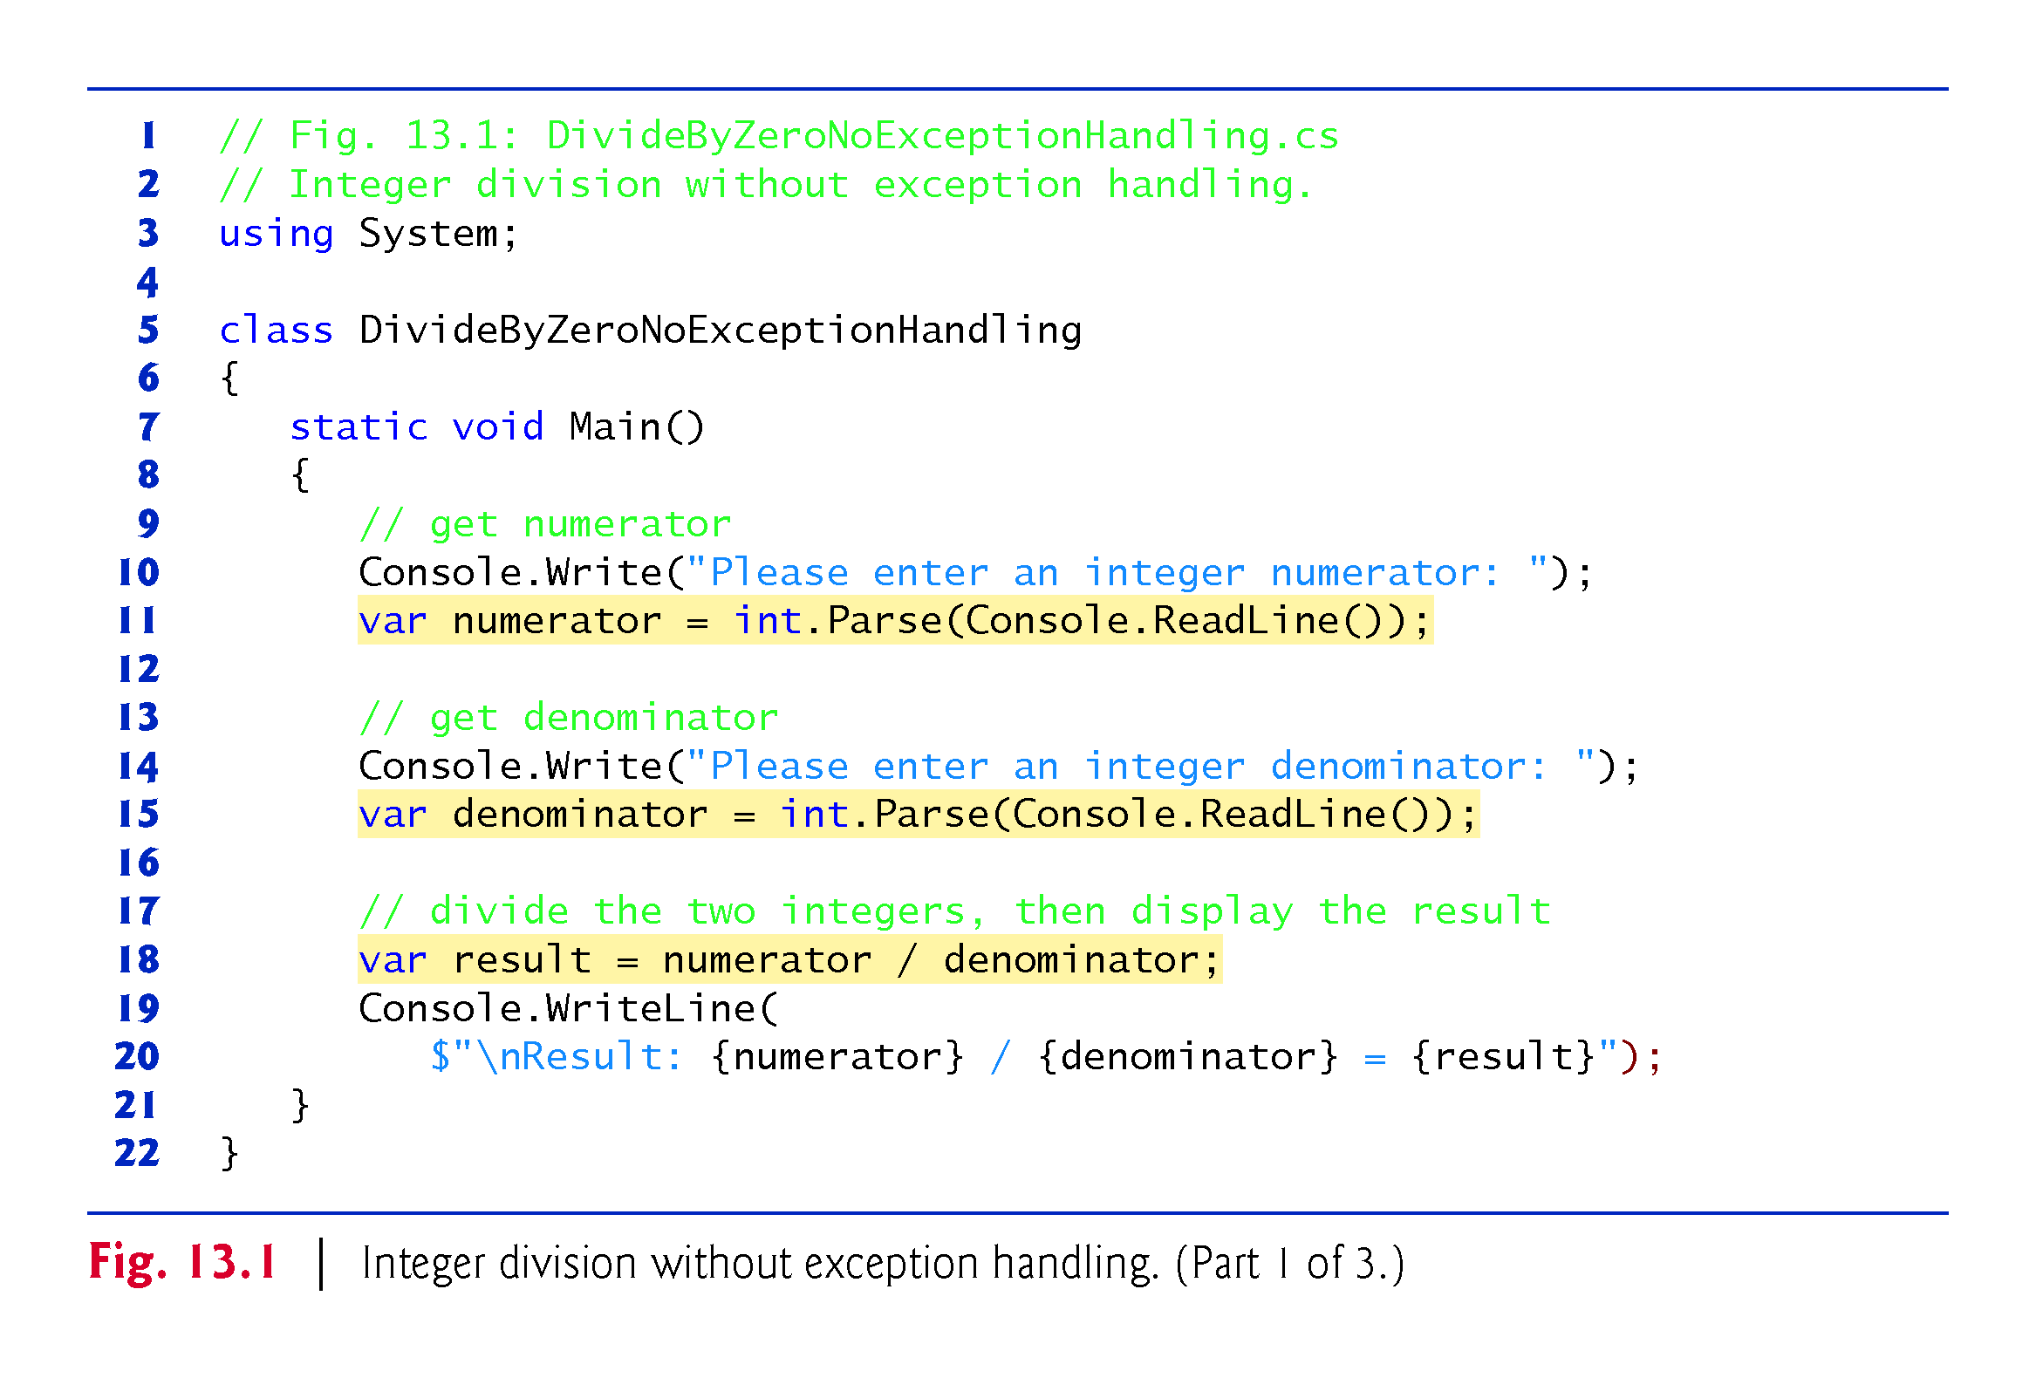
Reason to
use var

Slide 9
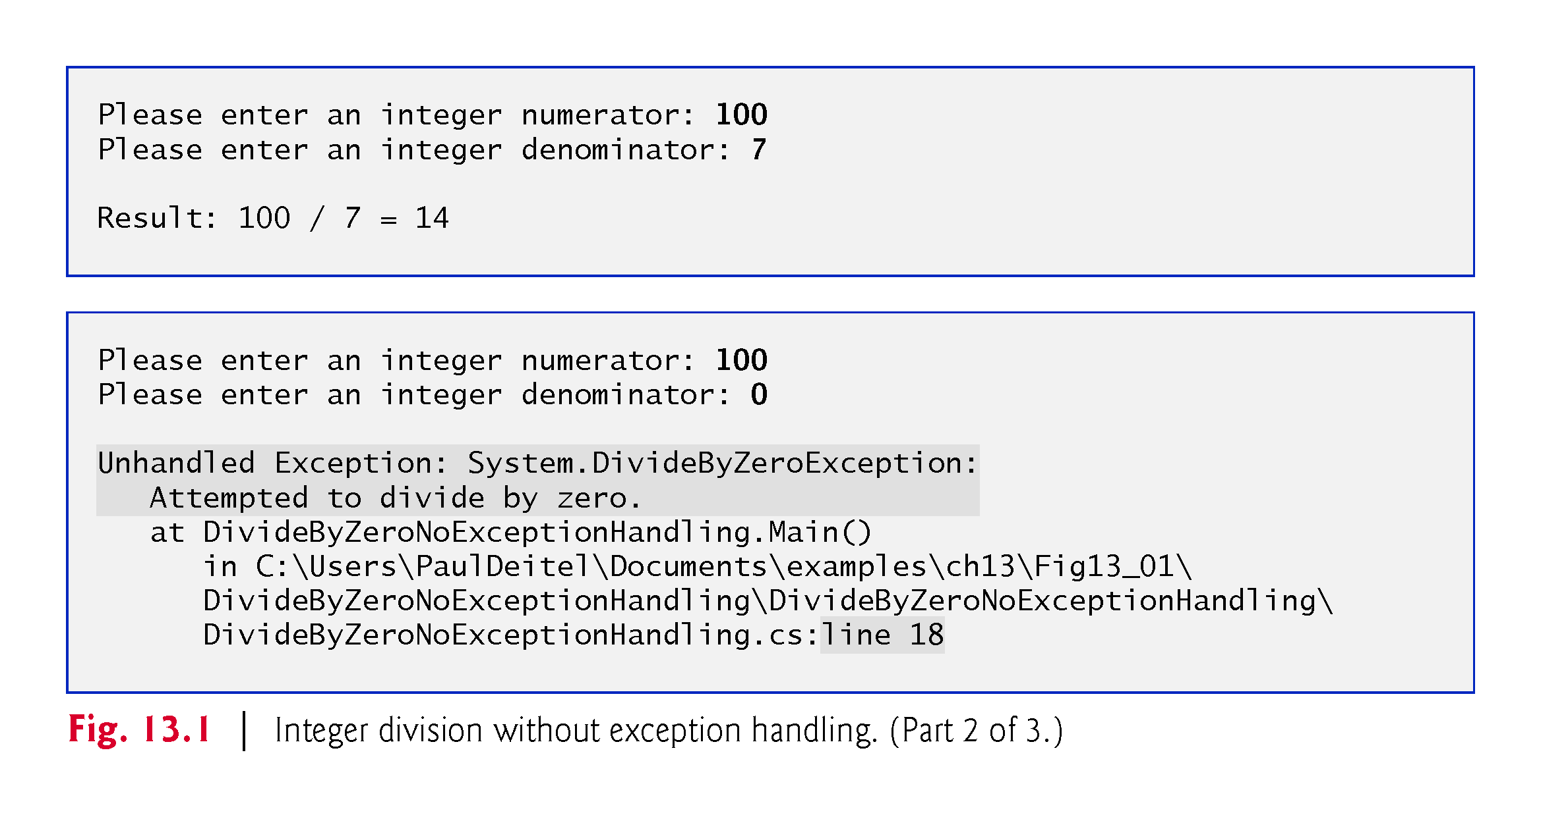

Slide 10
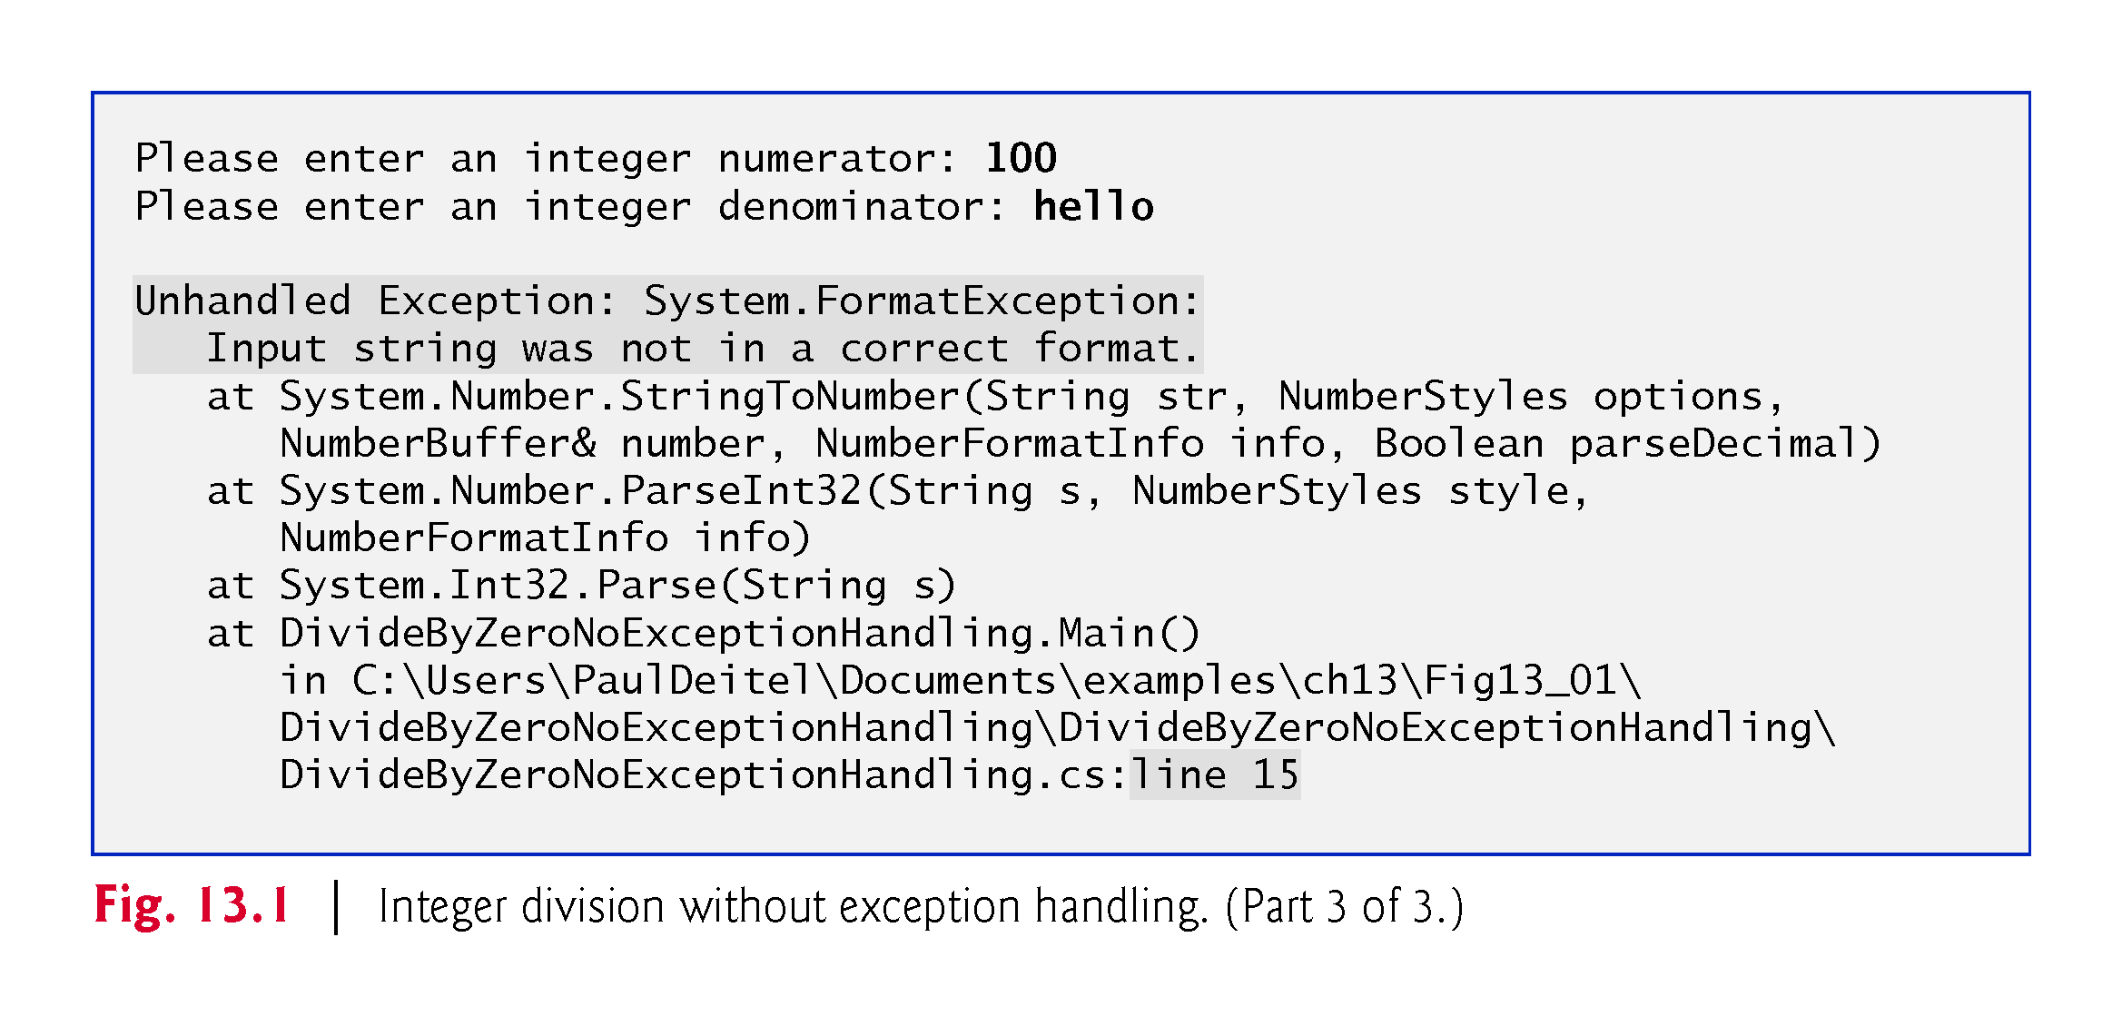

Slide 11
13.2 Example: Divide by Zero without Exception Handling (cont.)
The example in Fig. 13.1 might cause exceptions, depending on the user’s input.
Execute this app with Debug > Start Without Debugging.
If an exception occurs during execution, a dialog appears indicating that the app “has stopped working.”
Click Cancel or Close Program to terminate the app.
An error message describing the exception that occurred is displayed in the program’s output.

Slide 12
13.2 Example: Divide by Zero without Exception Handling (cont.)
A stack trace includes the exception class’s name in a message indicating the problem that occurred and the path of execution that led to the exception, method by method.
Stack traces help you debug a program.
The first line of the error message specifies the exception that occurred.
When a program divides an integer by 0, the CLR throws a DivideByZeroException.
Division by zero is not allowed in integer arithmetic.

Slide 13
13.2 Example: Divide by Zero without Exception Handling (cont.)
A FormatException occurs when int.Parse receives a string that does not represent a valid integer.
This program terminates when an unhandled exception occurs.
This does not always happen—sometimes a program may continue executing even though an exception has occurred and a stack trace has been displayed.
In such cases, the app may produce incorrect results. ??

Slide 14
13.3 Example: Handling DivideByZeroExceptions and FormatExceptions（uses exception handling）
The app in Fig. 13.2 uses exception handling to process DivideByZeroExceptions and FormatExceptions that might arise.
This program demonstrates how to catch and handle exceptions—in this case, displaying an error message and allowing the user to enter another set of values.

Slide 15
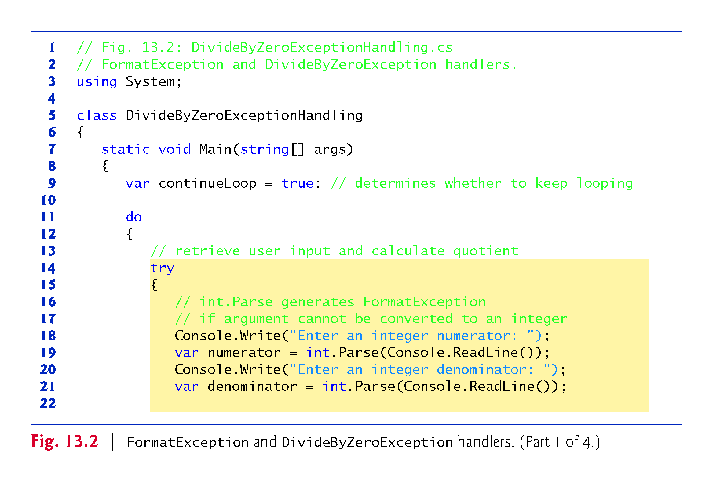
!!!

Slide 16
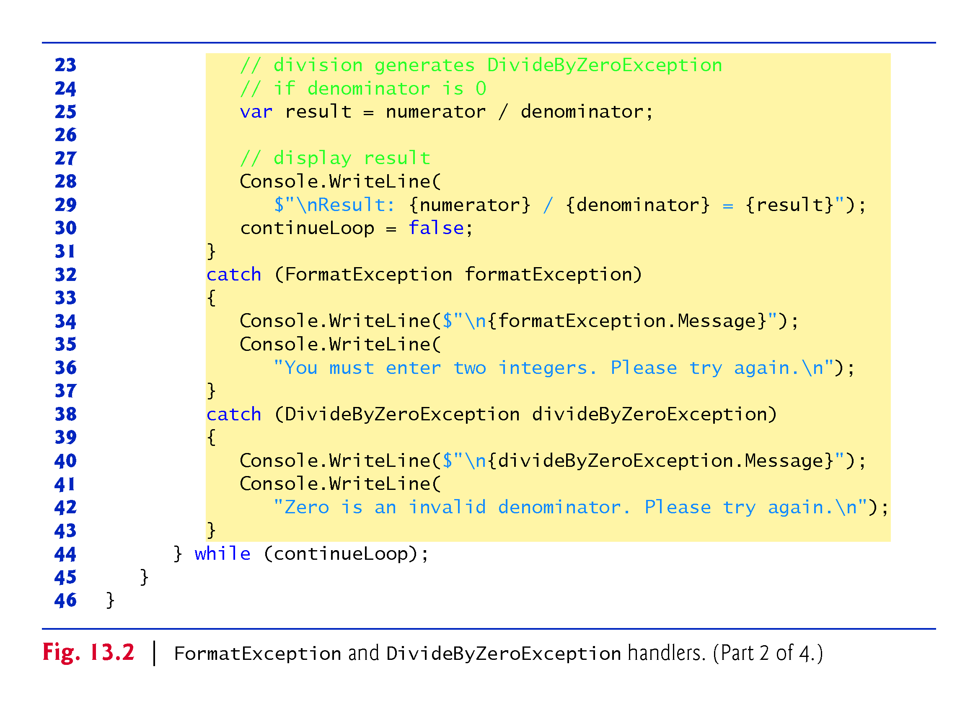

Slide 17
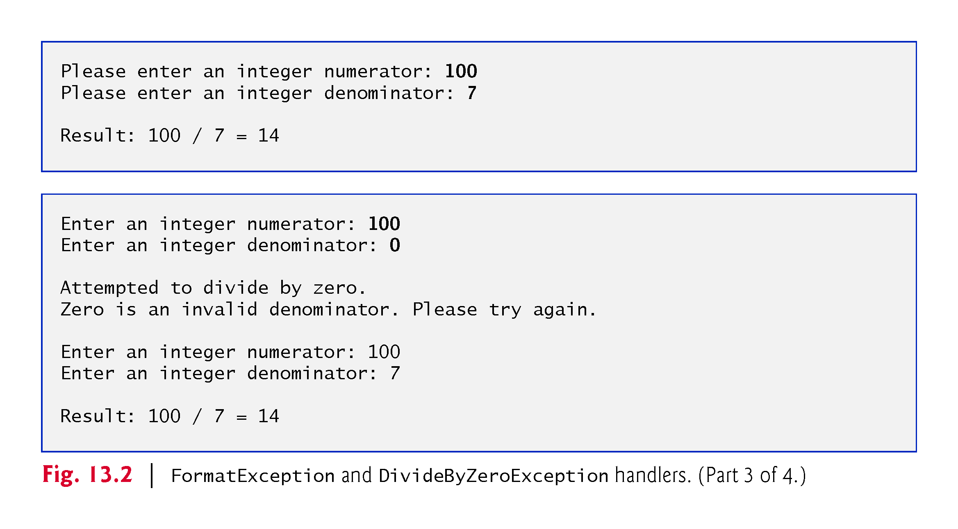

Slide 18
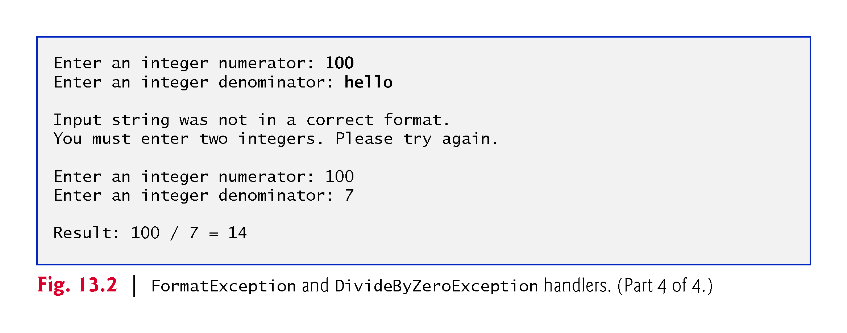

Slide 19

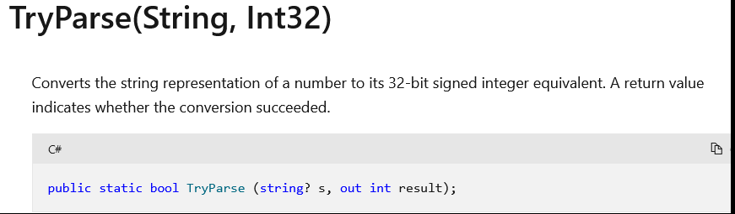
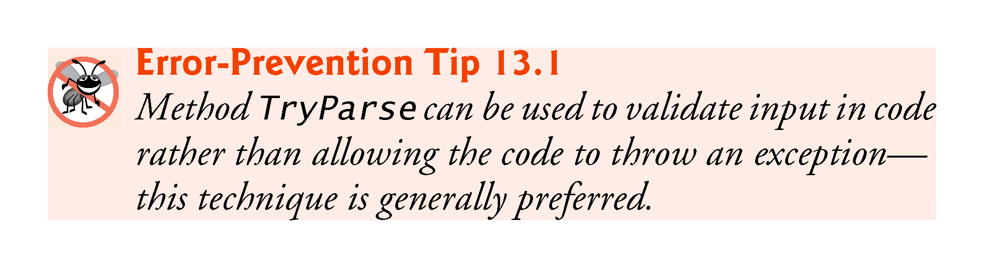
Instead of let exception happen, parse&check
Reason to declare as var
Instead of int??

Slide 20
13.3 Example: Handling DivideByZeroExceptions and FormatExceptions (cont).
The Int32.TryParse method converts a string to an int value if possible.
The method requires two arguments—one is the string to parse and the other is the variable in which the converted value is to be stored.
The method returns a bool value that’s true if the string was parsed successfully.
If the string could not be converted, the value 0 is assigned to the second argument.
!!!

Slide 21
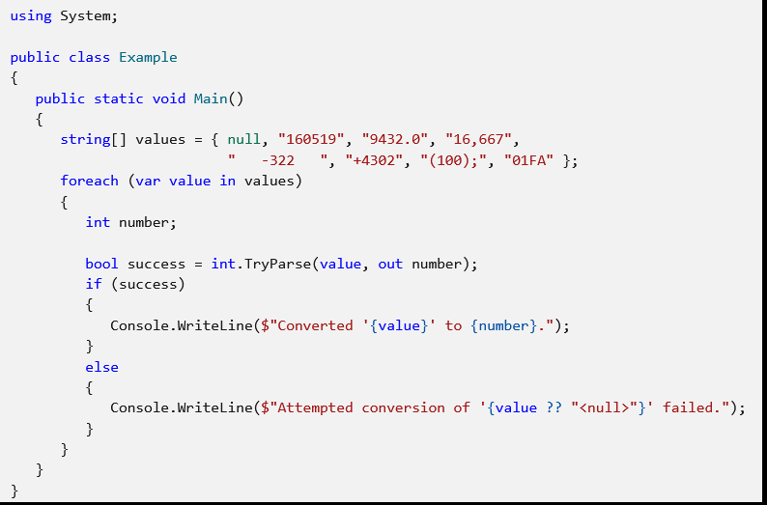
Notes:
String?

Slide 22
!!!

Slide 23
13.3.1 Enclosing Code in a try Block
A try block encloses code that might throw exceptions, as well as the code that’s skipped when an exception occurs. ?

Slide 24
13.3.2 Catching Exceptions
When an exception occurs in a try block, a corresponding catch block catches the exception and handles it.
At least one catch block must immediately follow a try block.
A catch block specifies an exception parameter representing the exception that the catch block can handle.
Optionally, you can include a catch block that does not specify an exception type to catch all exception types. （not recommended, same like using default exception handler）

Slide 25
13.3.3 Uncaught Exceptions
An uncaught exception (or unhandled exception) is an exception for which there is no matching catch block.
If you run the app by using Debug > Start Debugging and the runtime environment detects an uncaught exception, the app pauses, and the Exception Assistant (Fig. 13.3) appears.

Slide 26
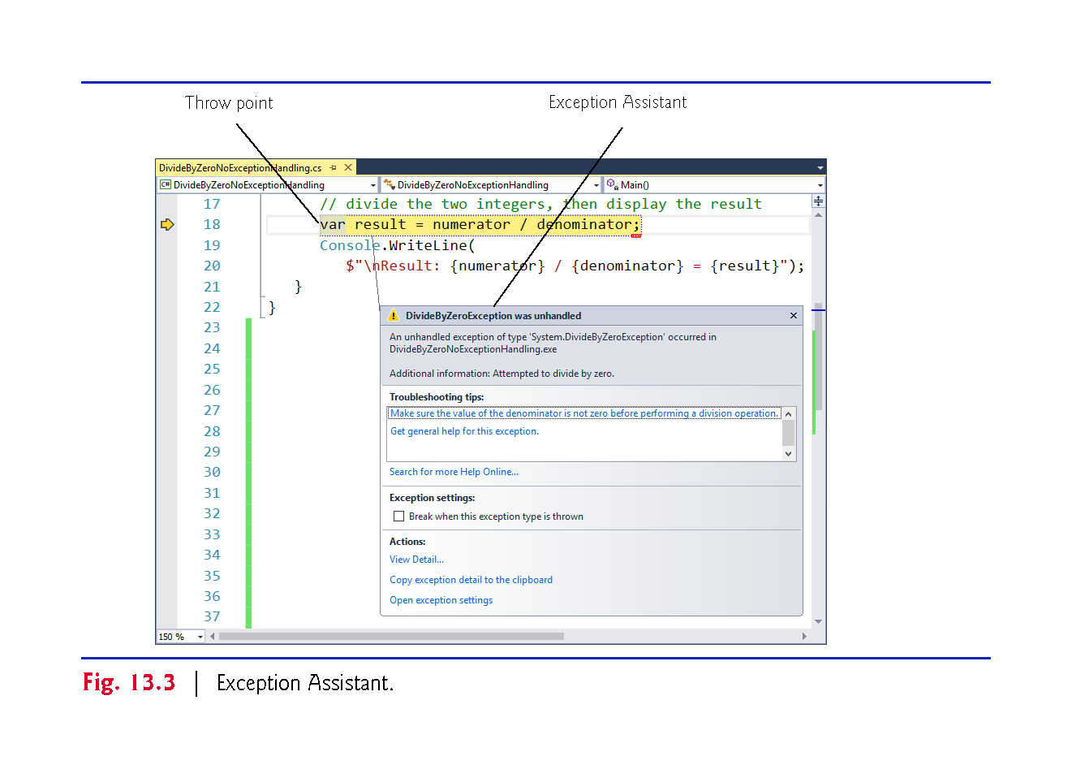

Slide 27
13.3.4 Termination Model of Exception Handling
The point at which an exception occurs is called the throw point.
If an exception occurs in a try block, program control immediately transfers to the first catch block matching the type of the thrown exception.
After the exception is handled, program control resumes after the last catch block.
This is known as the termination model of exception handling.

Slide 28
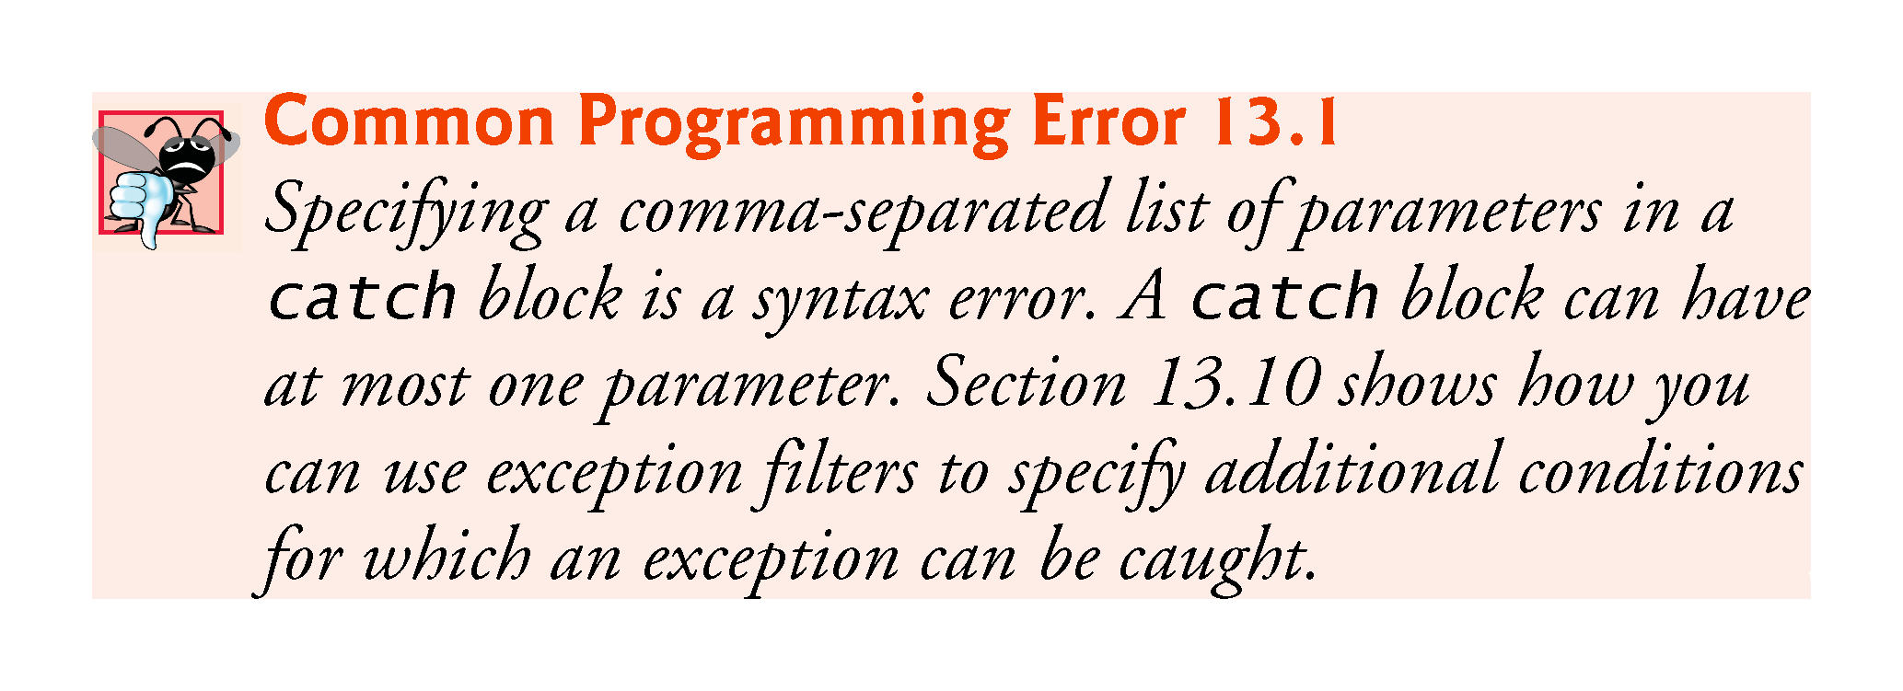
???

Slide 29
13.4 .NET Exception Hierarchy
In C#, only objects of class Exception and its derived classes may be thrown and caught.
Exceptions thrown in other .NET languages can be caught with the general catch clause.

Slide 30
13.4.1 Class SystemException
Class Exception is the base class of .NET’s exception class hierarchy.
The CLR generates SystemExceptions.
If a program attempts to access an out-of-range array index, the CLR throws an exception of type IndexOutOfRangeException.
Attempting to use a null reference causes a NullReferenceException.

Slide 31
13.4.1 Class SystemException(p)
A catch block can use a base-class type to catch a hierarchy of related exception types.
A catch block that specifies a parameter of type Exception can catch all exceptions.
This technique makes sense only if the handling behavior is the same for a base class and all derived classes. ??

Slide 32
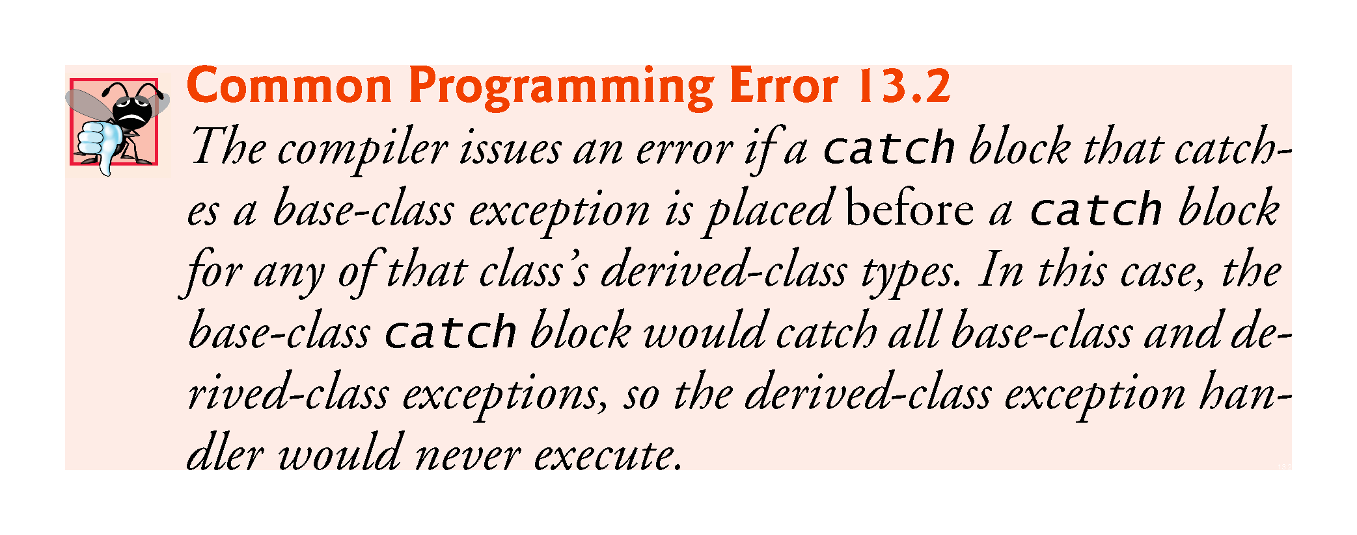
p

Slide 33
13.4.2 Which Exceptions Might a Method Throw?
Search for “int.Parse method” in the Visual Studio online documentation.
The Exceptions section of this method’s web page indicates that method int.Parse throws exception types
ArgumentNullException
FormatException
OverflowException
and describes the reason for each.

Slide 34
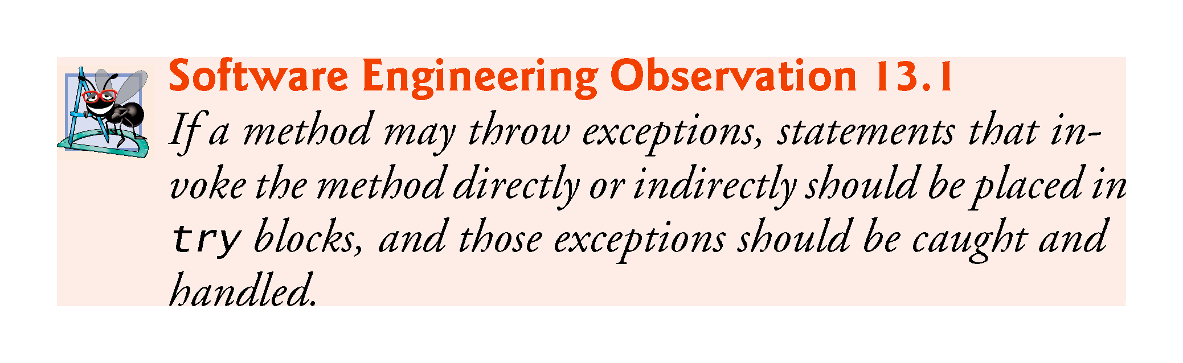

Slide 35
13.5 finally Block
Programs frequently request and release resources dynamically.
Operating systems typically prevent more than one program from manipulating a file.
Therefore, the program should close the file (i.e., release the resource) so other programs can use it.
If the file is not closed, a resource leak occurs.

Slide 36
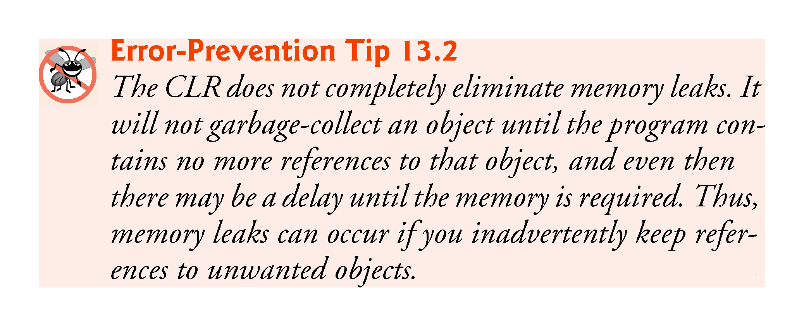
??
!!!

Slide 37
13.5.1 Moving Resource-Release Code to a finally Block p
Exceptions often occur when an app processes resources that require explicit release.??
Regardless of whether a program experiences exceptions, the program should close the file when it is no longer needed.
C# provides the finally block, which is guaranteed to execute regardless of whether an exception occurs.(catch block is not guarantee to execute)
This makes the finally block ideal to release resources from the corresponding try block(claim resource in try).

Slide 38
13.5 finally Block (Cont.)
Local variables in a try block cannot be accessed in the corresponding finally block??, so variables that must be accessed in both should be declared before the try block. (diff from Java, all variables need to declare from the beginning)

Slide 39
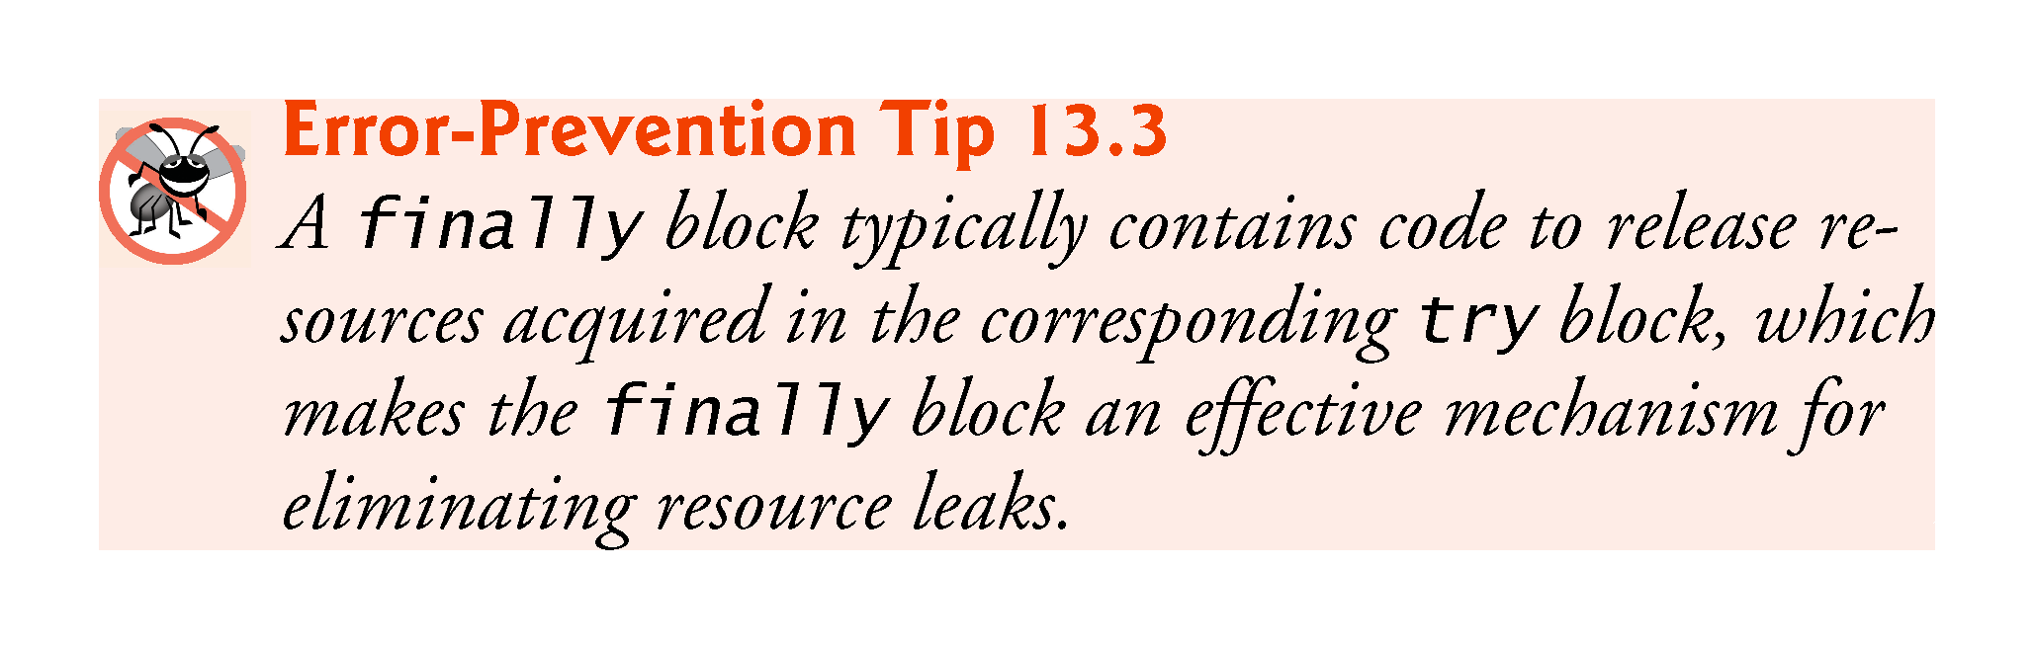
Such as DB connection???
!!!
Reason to release resource in finally,
Not catch???

Slide 40
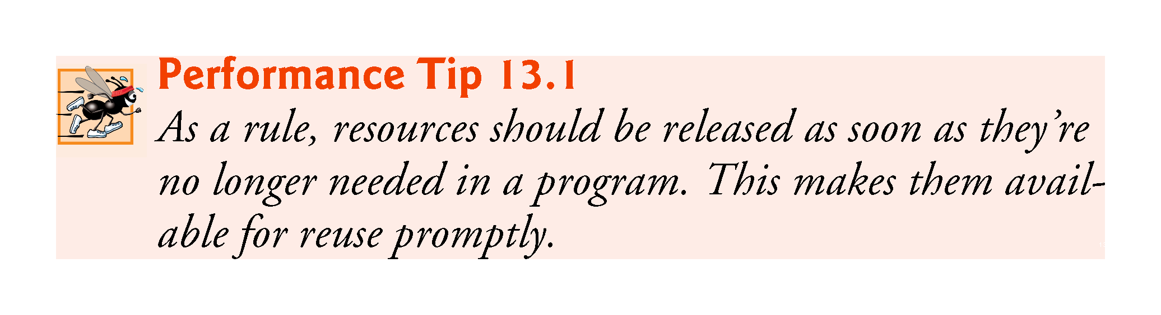
!!!

Slide 41
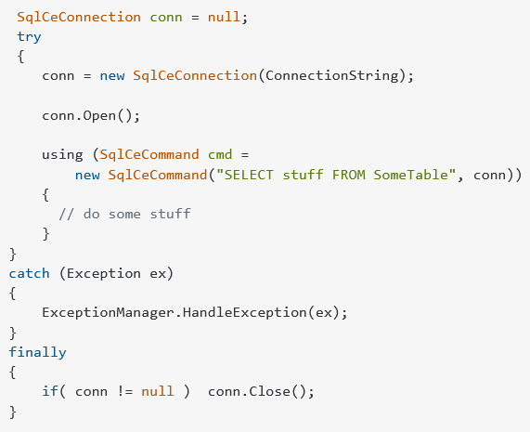
https://stackoverflow.com/questions/2681097/correct-way-to-close-database-connection-in-event-of-exception
There is a limitation number of connection to a single data source resource, If the resource is not released afterward when done with it, there is resource leak
!!!
Q&A: What might happen if resource releasing code in catch instead of finally!!!

Slide 42
13.5.2 Demonstrating the finally Block
The app in Fig. 13.4 demonstrates that the finally block always executes, regardless of whether an exception occurs in the corresponding try block.

Slide 43
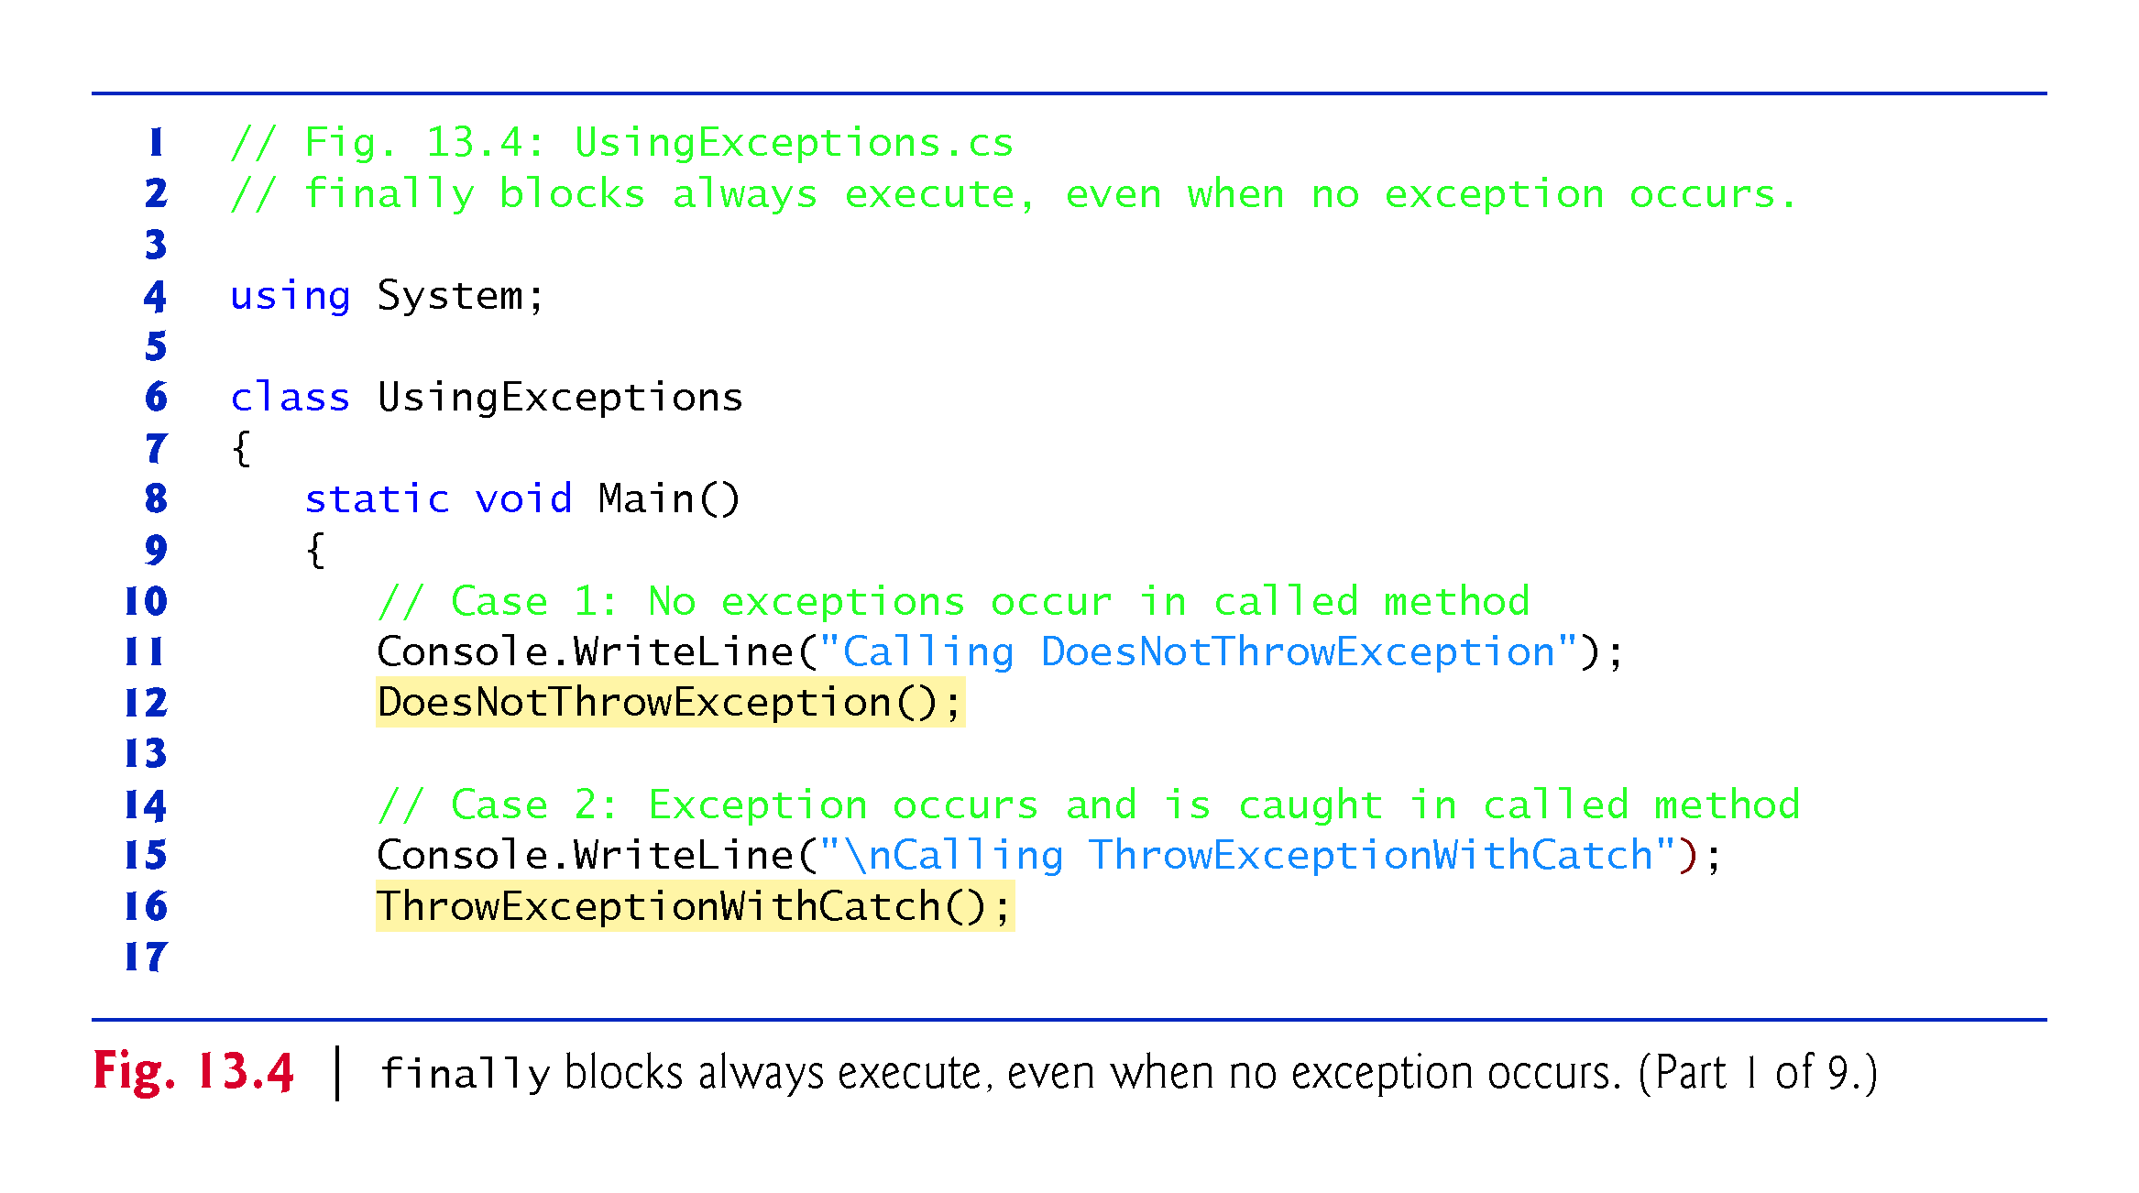

Slide 44
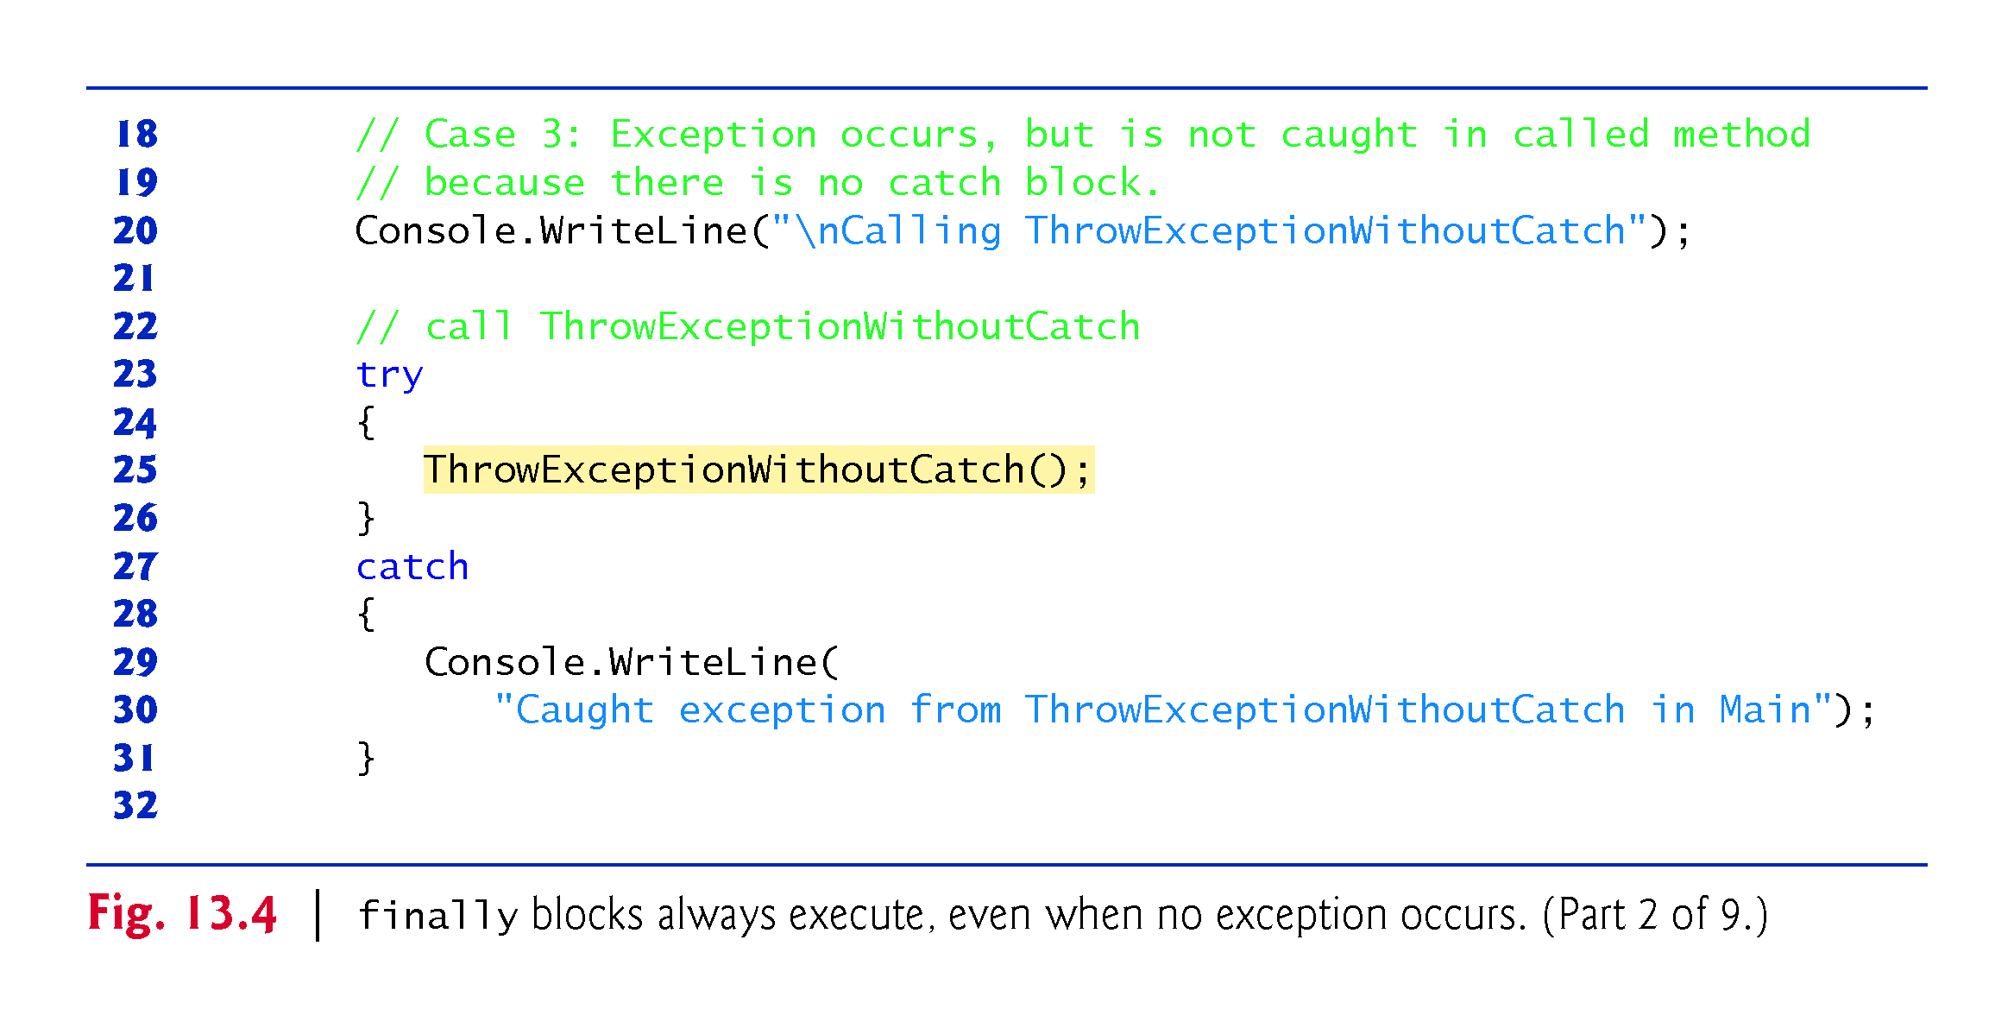

Slide 45
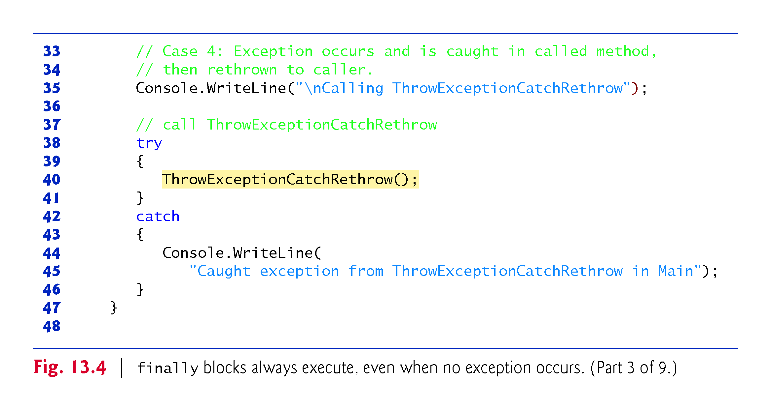

Slide 46
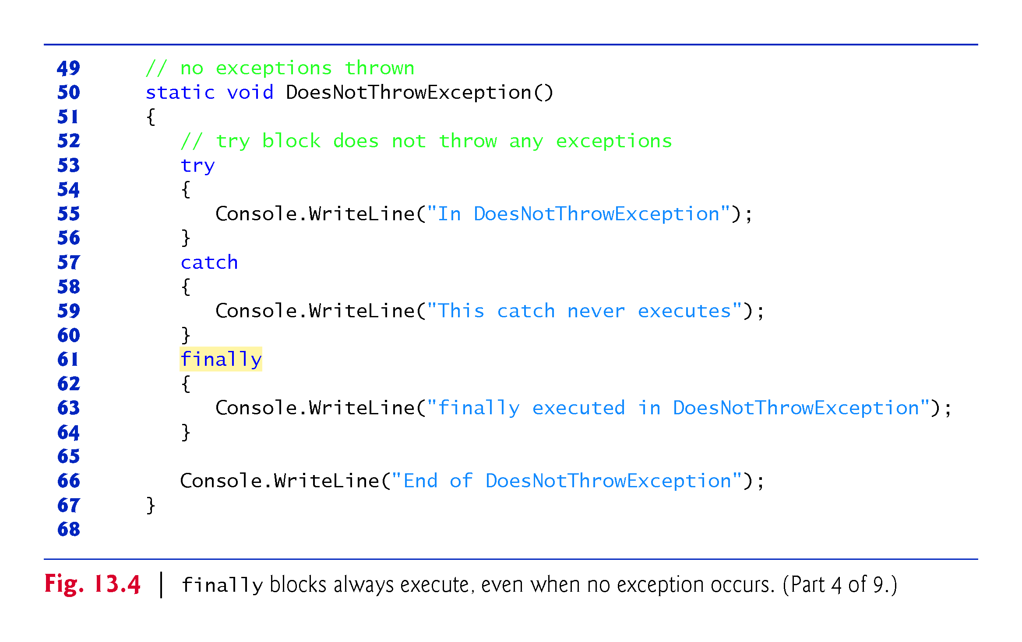

Slide 47
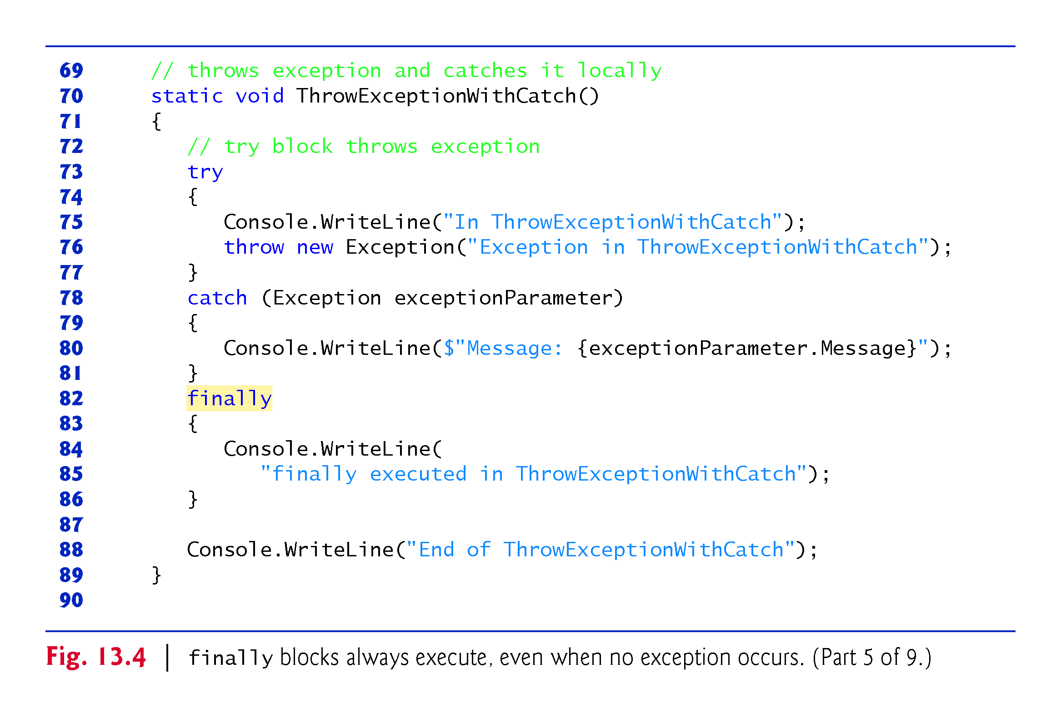

Slide 48
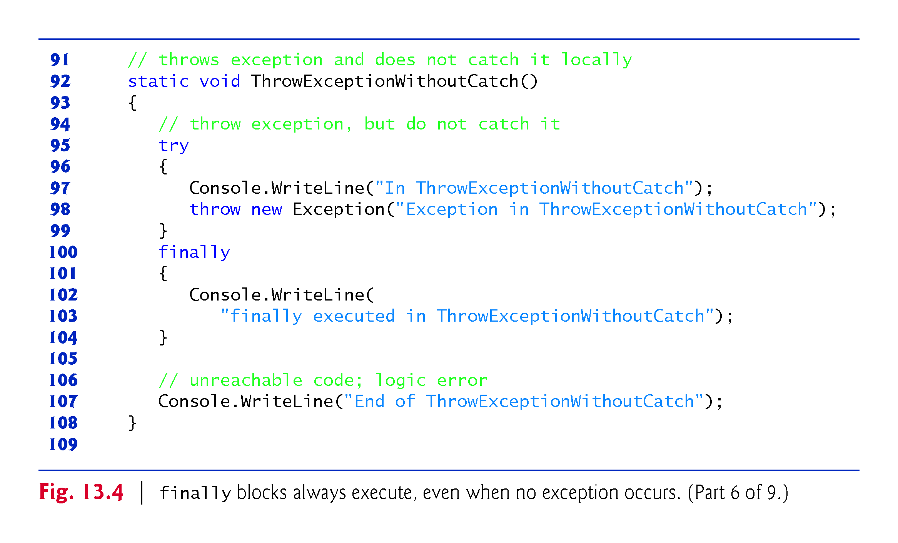

Slide 49
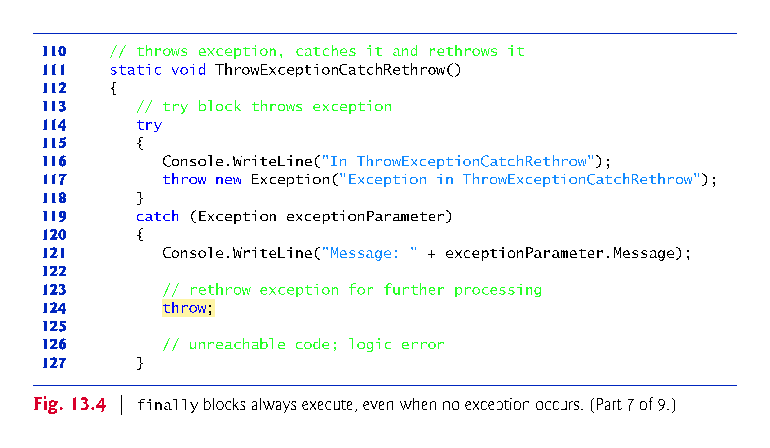

Slide 50
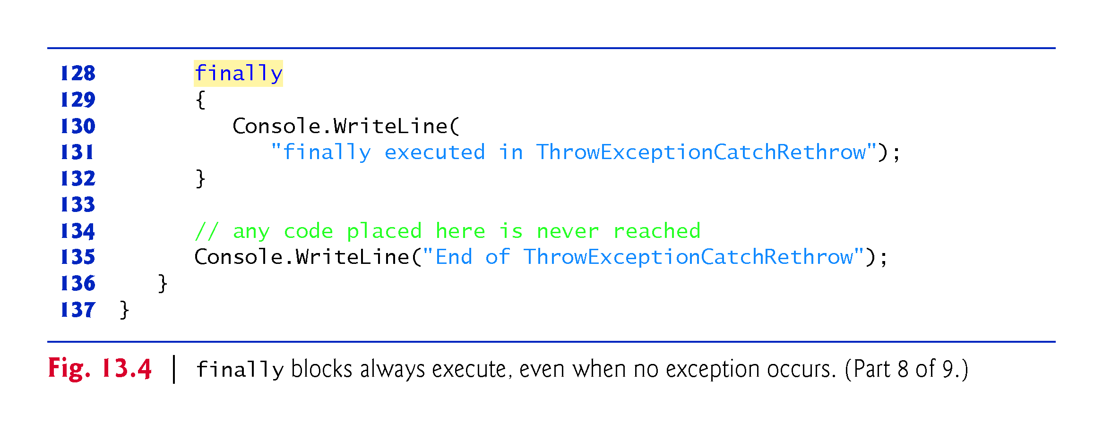

Slide 51
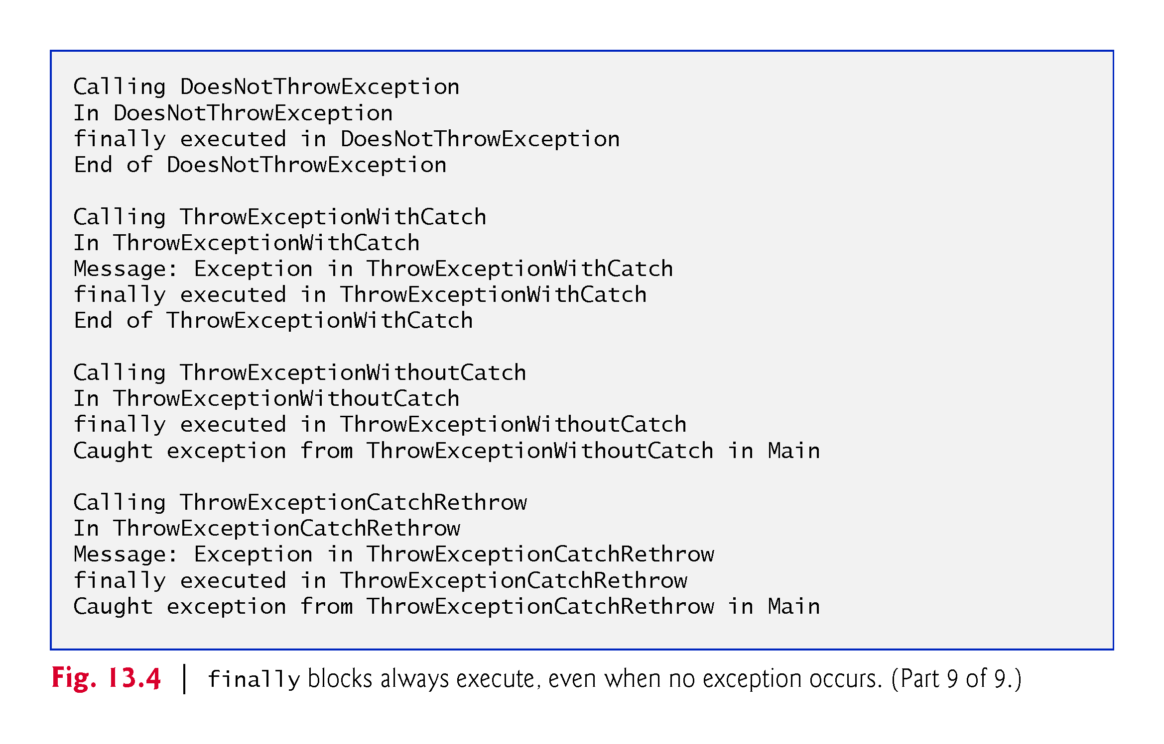

Slide 52
13.5.3 Throwing Exceptions Using the throw Statement?
You create and throw an exception with the throw statement
Executing the throw statement indicates that a problem has occurred in the code.
A throw statement specifies an object to be thrown. The operand of a throw statement can be of type Exception or of any type derived from class Exception.

Slide 53
13.5.4 Rethrowing Exceptions?
You also can rethrow an exception with a version of the throw statement which takes an operand that’s the reference to the exception that was caught.
This form of throw statement resets the throw point, so the original throw point’s stack-trace information is lost. ?
Later, you’ll see that after an exception is caught, you can create and throw a different type of exception object from the catch block and you can include the original exception as part of the new exception object.
Class library designers often do this to customize the exception types thrown from methods in their class libraries or to provide additional debugging information

Slide 54
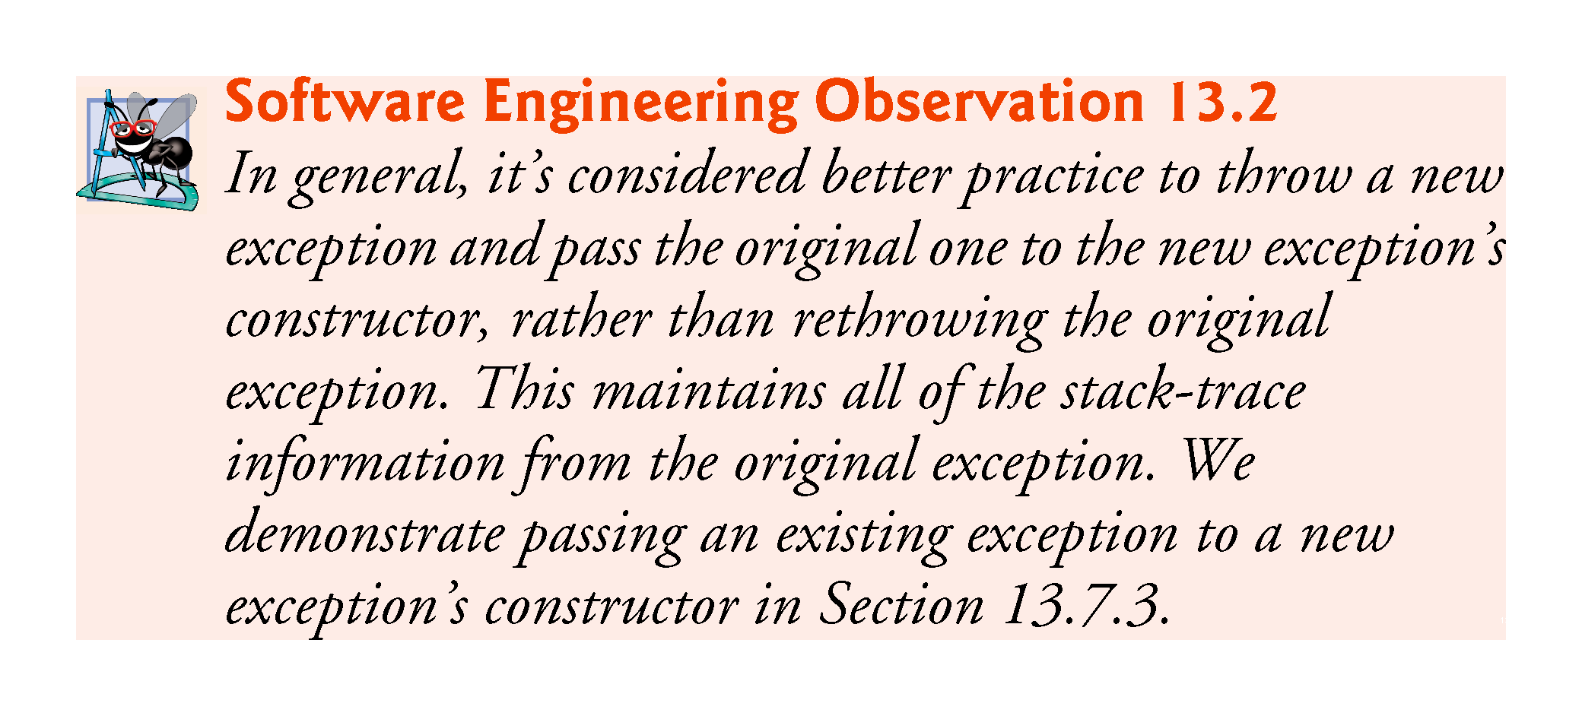

Slide 55
13.5.5 Returning After a finally Block?
If a try block successfully completes, or if a catch block catches and handles an exception, the program continues its execution with the next statement after the finally block.
If an exception is not caught, or if a catch block rethrows an exception, program control continues in the next enclosing try block.
The enclosing try could be in the calling method or in one of its callers.
It also is possible to nest a try statement in a try block; in such a case, the outer try statement’s catch blocks would process any exceptions that were not caught in the inner try statement.
If a try block executes and has a corresponding finally block, the finally block executes even if the try block terminates due to a return statement.
The return occurs after the execution of the finally block.

Slide 56
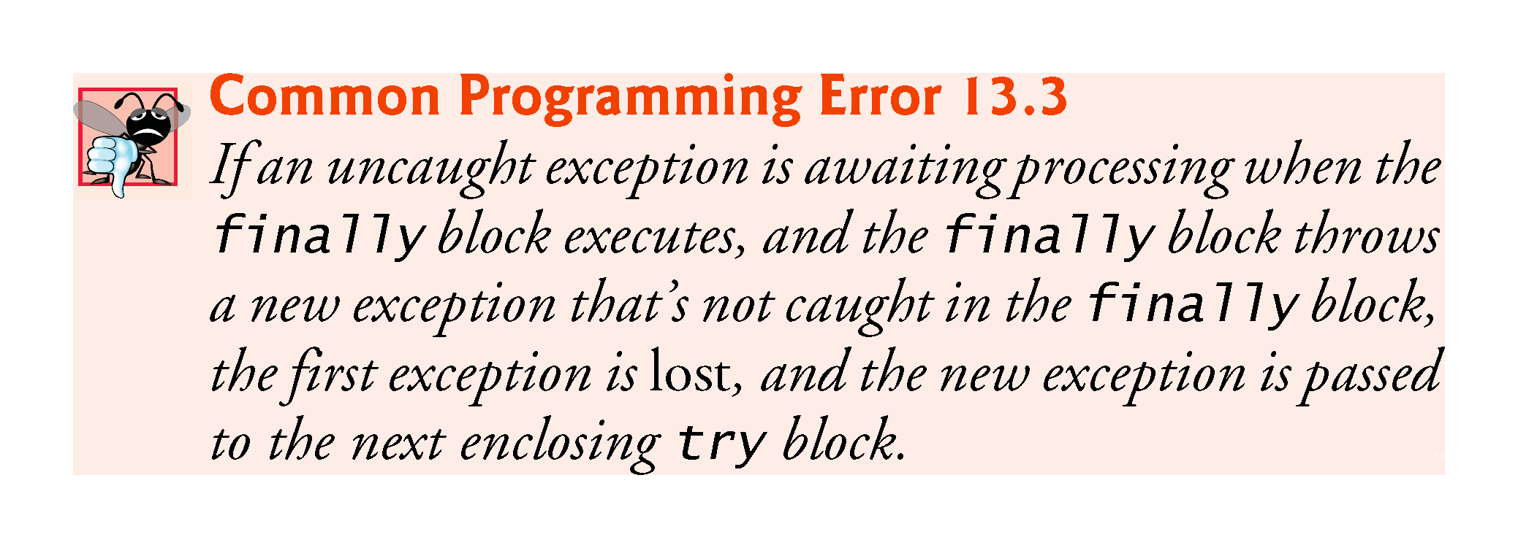

Slide 57
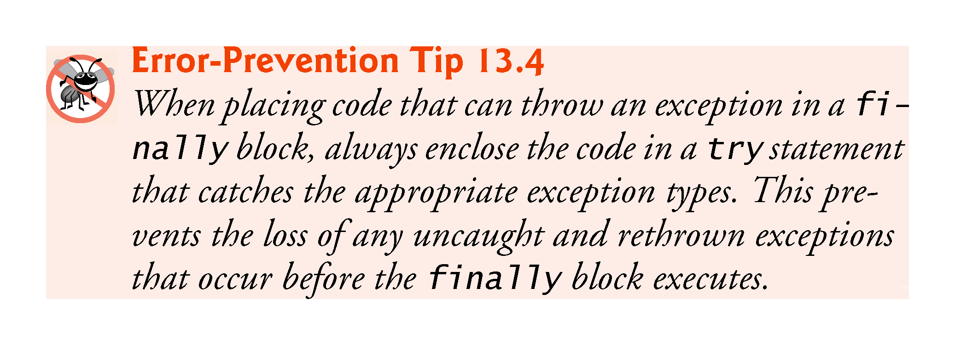

Slide 58
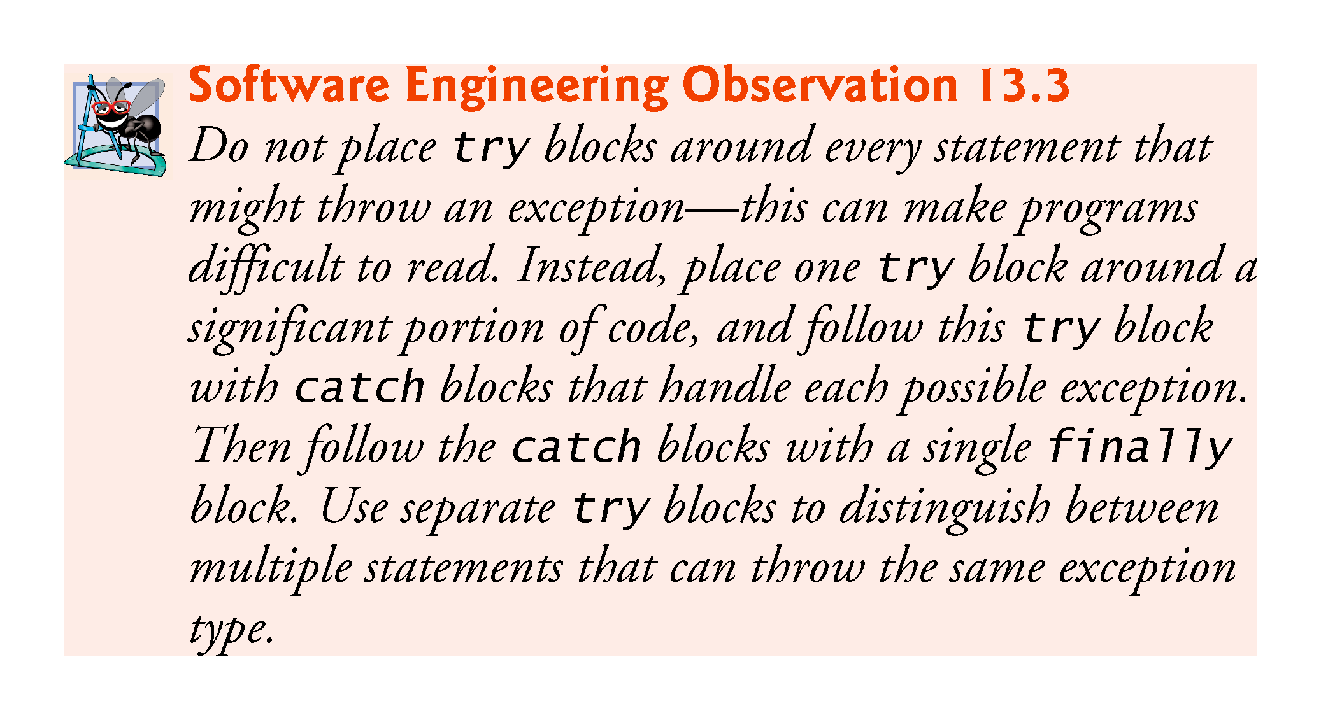

Slide 59
13.6 The using statement p
The using statement simplifies writing code in which you obtain a resource(or /release).
The general form of a using statement is:
using (var exampleObject = new ExampleClass()) { exampleObject.SomeMethod(); }
!!!

Slide 60
13.6 The using statement (Cont.)
The using statement code is equivalent to
{ var exampleObject = new ExampleClass(); try { exampleObject.SomeMethod();//ex:DB connection } finally { if (exampleObject != null) { ((IDisposable) exampleObject).Dispose(); } } }

Slide 61
13.7 Exception Properties ?ignore
Class Exception’s properties are used to formulate error messages indicating a caught exception.
Property Message stores the error message associated with an Exception object.
Property StackTrace contains a string that represents the method-call stack.
If the debugging information that’s generated by the compiler for the method is accessible to the IDE, the stack trace also includes line numbers; the first line number indicates the throw point, and subsequent line numbers indicate the locations from which the methods in the stack trace were called.
The IDE creates PDB files to maintain the debugging information for your projects.

Slide 62
13.7.1 Property InnerException ?ignore
When an exception occurs, a programmer might use a different error message or indicate a new exception type.
The original exception object is stored in the InnerException property.

Slide 63
13.7.2 Other Exception Properties ?ignore
Class Exception provides other properties:
HelpLink specifies the location of a help file that describes the problem.
Source specifies the name of the app or object that caused the exception.
TargetSite specifies the method where the exception originated.

Slide 64
13.7.3 Demonstrating Exception Properties and Stack Unwinding ?ignore
Fig. 13.5 demonstrates properties of class Exception.

Slide 65
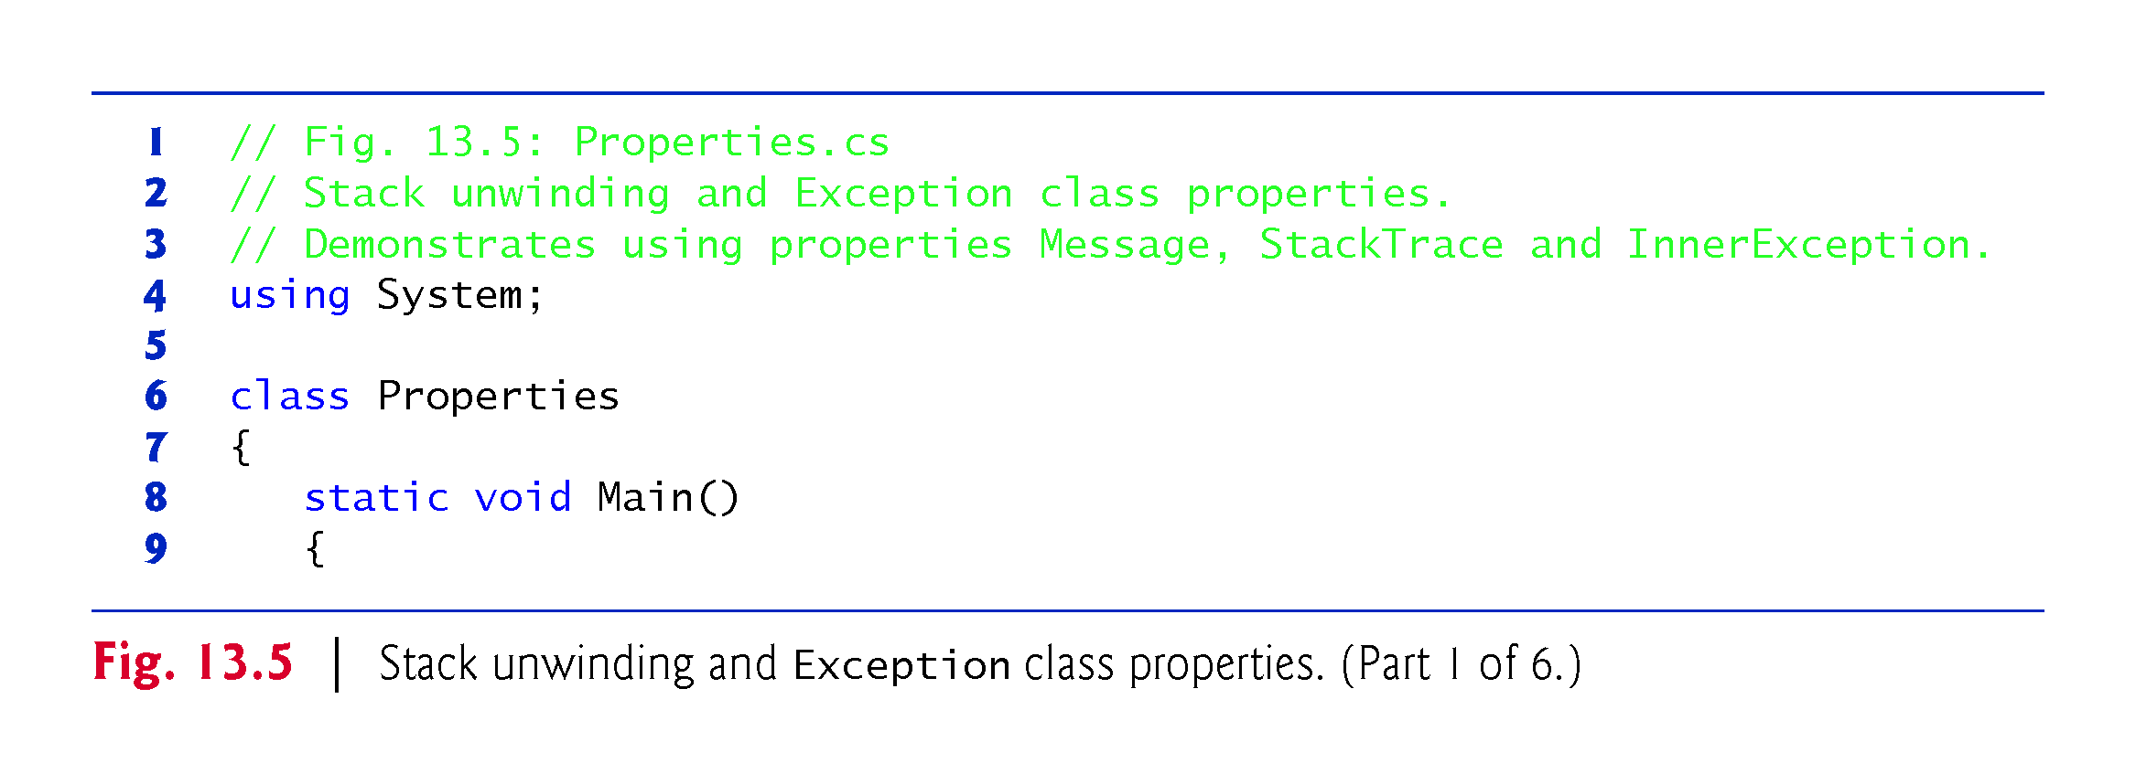

Slide 66
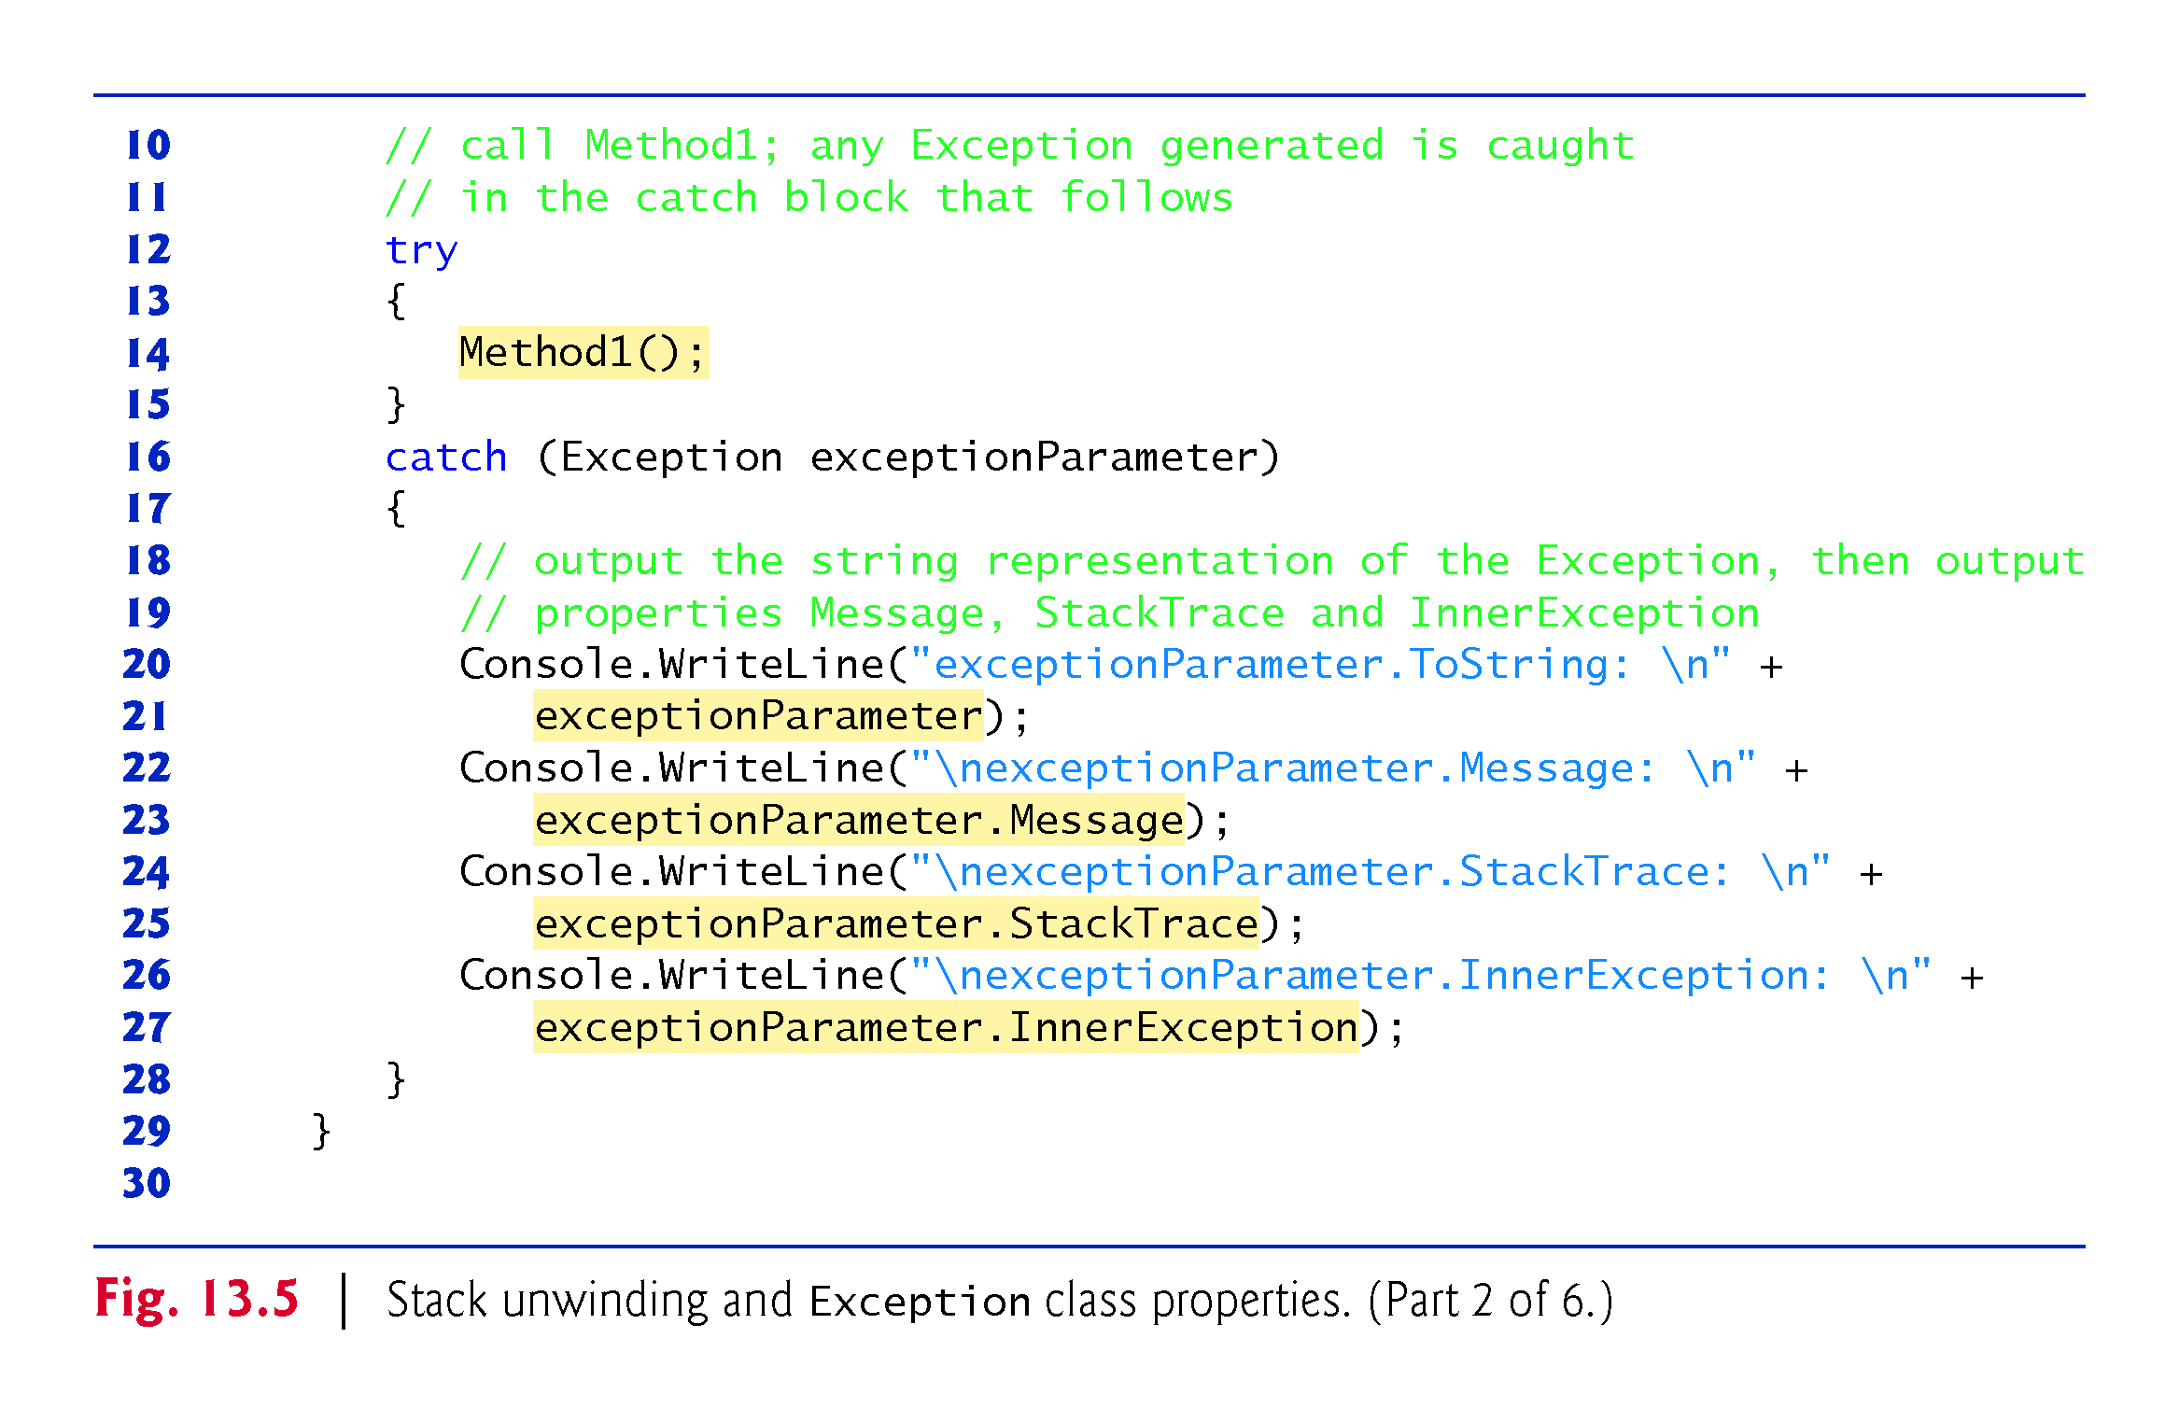

Slide 67
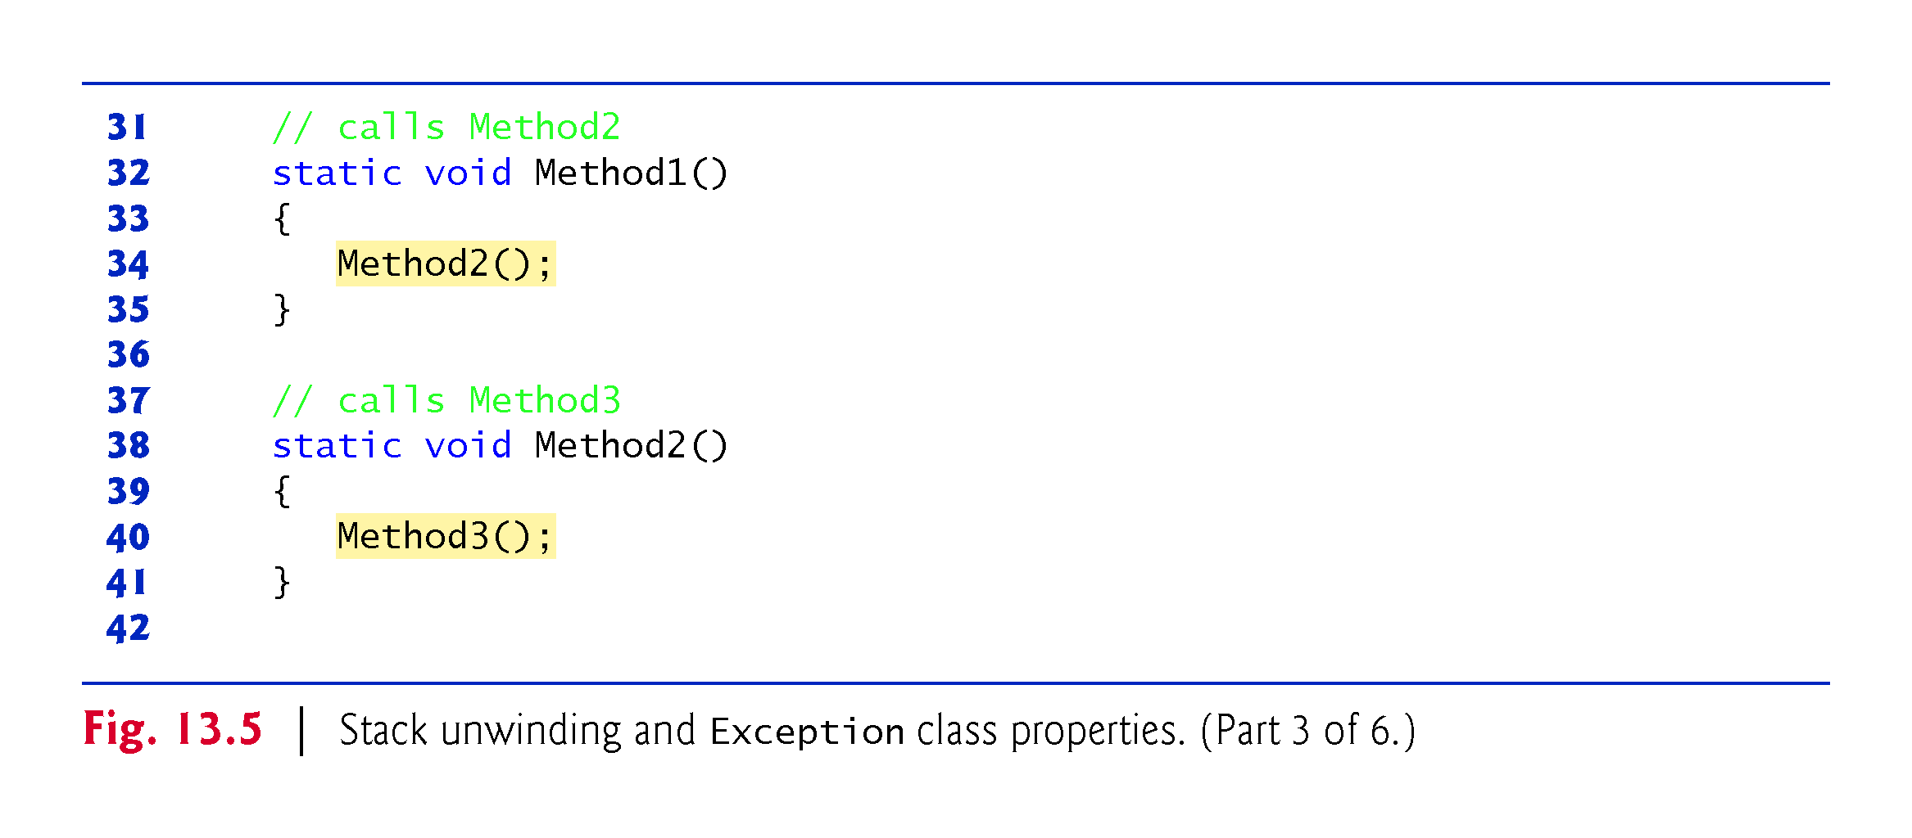

Slide 68
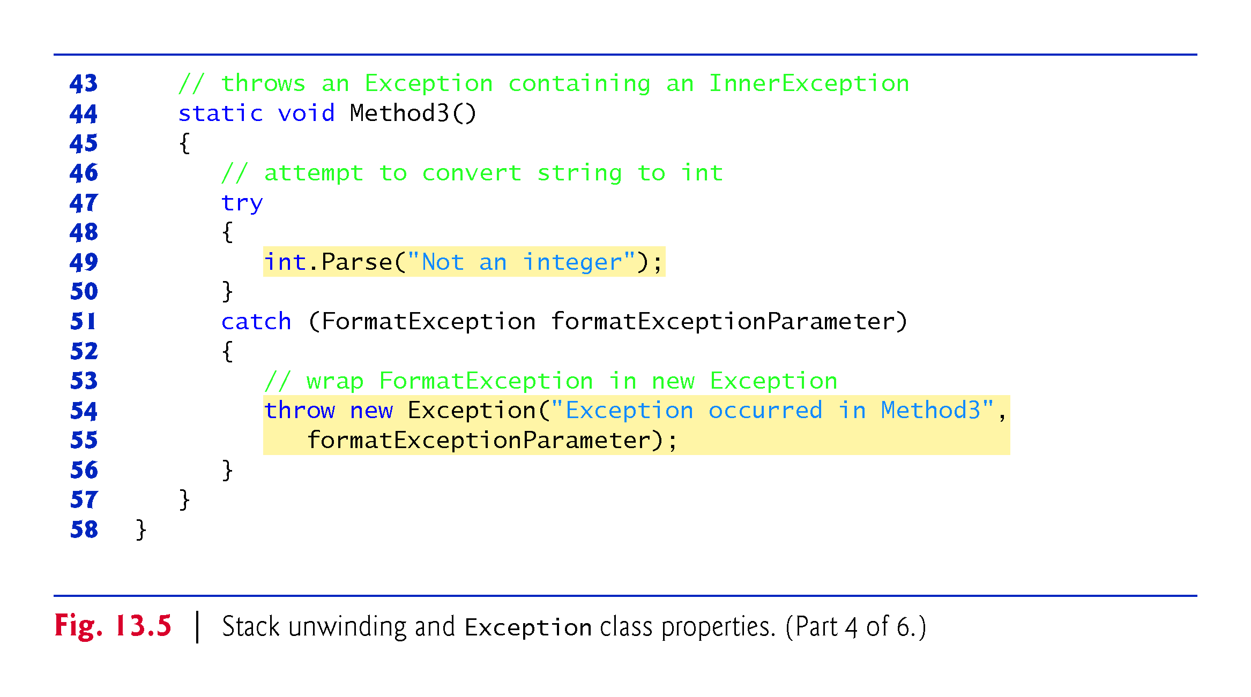

Slide 69
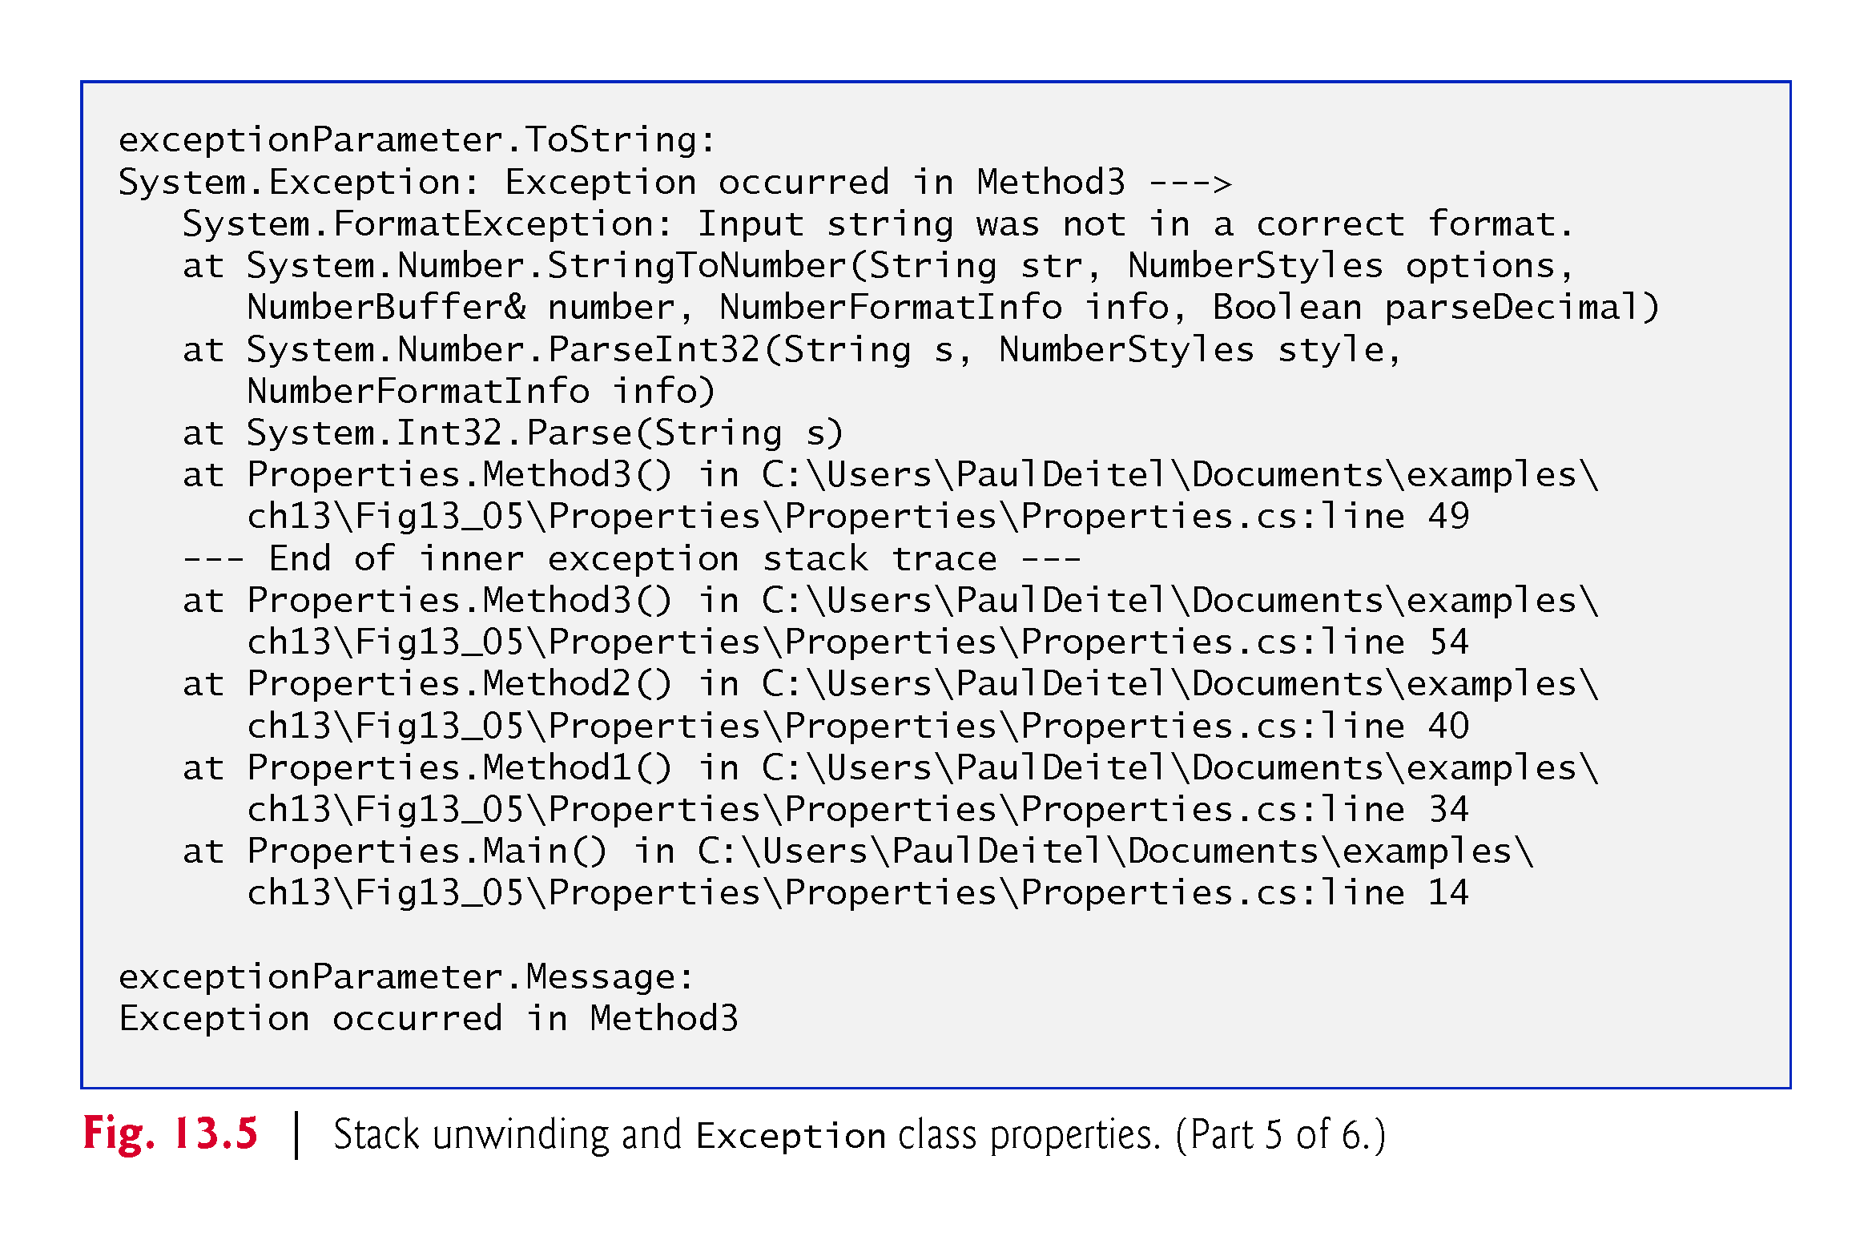

Slide 70
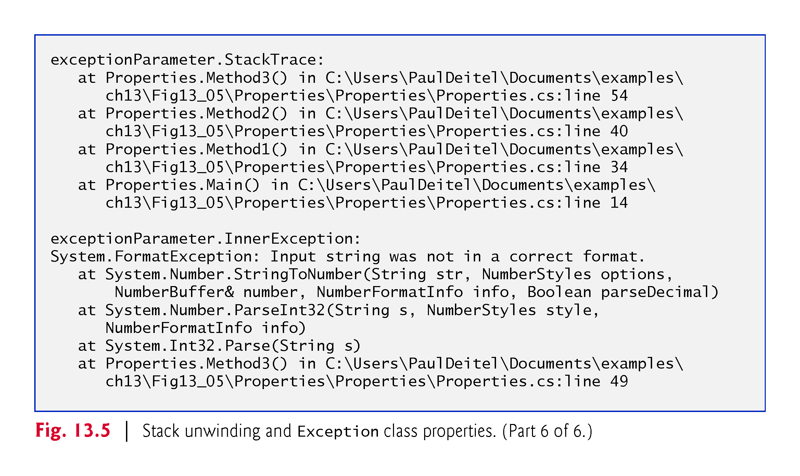

Slide 71
13.7.4 Throwing an Exception with an InnerException ?ignore
The Exception class’s two-argument constructor receives
the custom error message and the
InnerException to provide as additional information

Slide 72
13.7.5 Displaying Information About the Exception ?ignore
Exception method ToString returns a string that begins with the name of the exception class followed by the Message property value.
The next items present the stack trace of the InnerException object.
The remainder of the block of output shows the StackTrace for the exception.
The StackTrace represents the state of the method-call stack at the throw point of the exception, rather than at the point where the exception eventually is caught.
Each StackTrace line that begins with “at” represents a method on the call stack.
These indicate the method in which the exception occurred, the file in which the method resides and the line number of the throw point in the file. The inner-exception information includes the inner-exception stack trace.

Slide 73
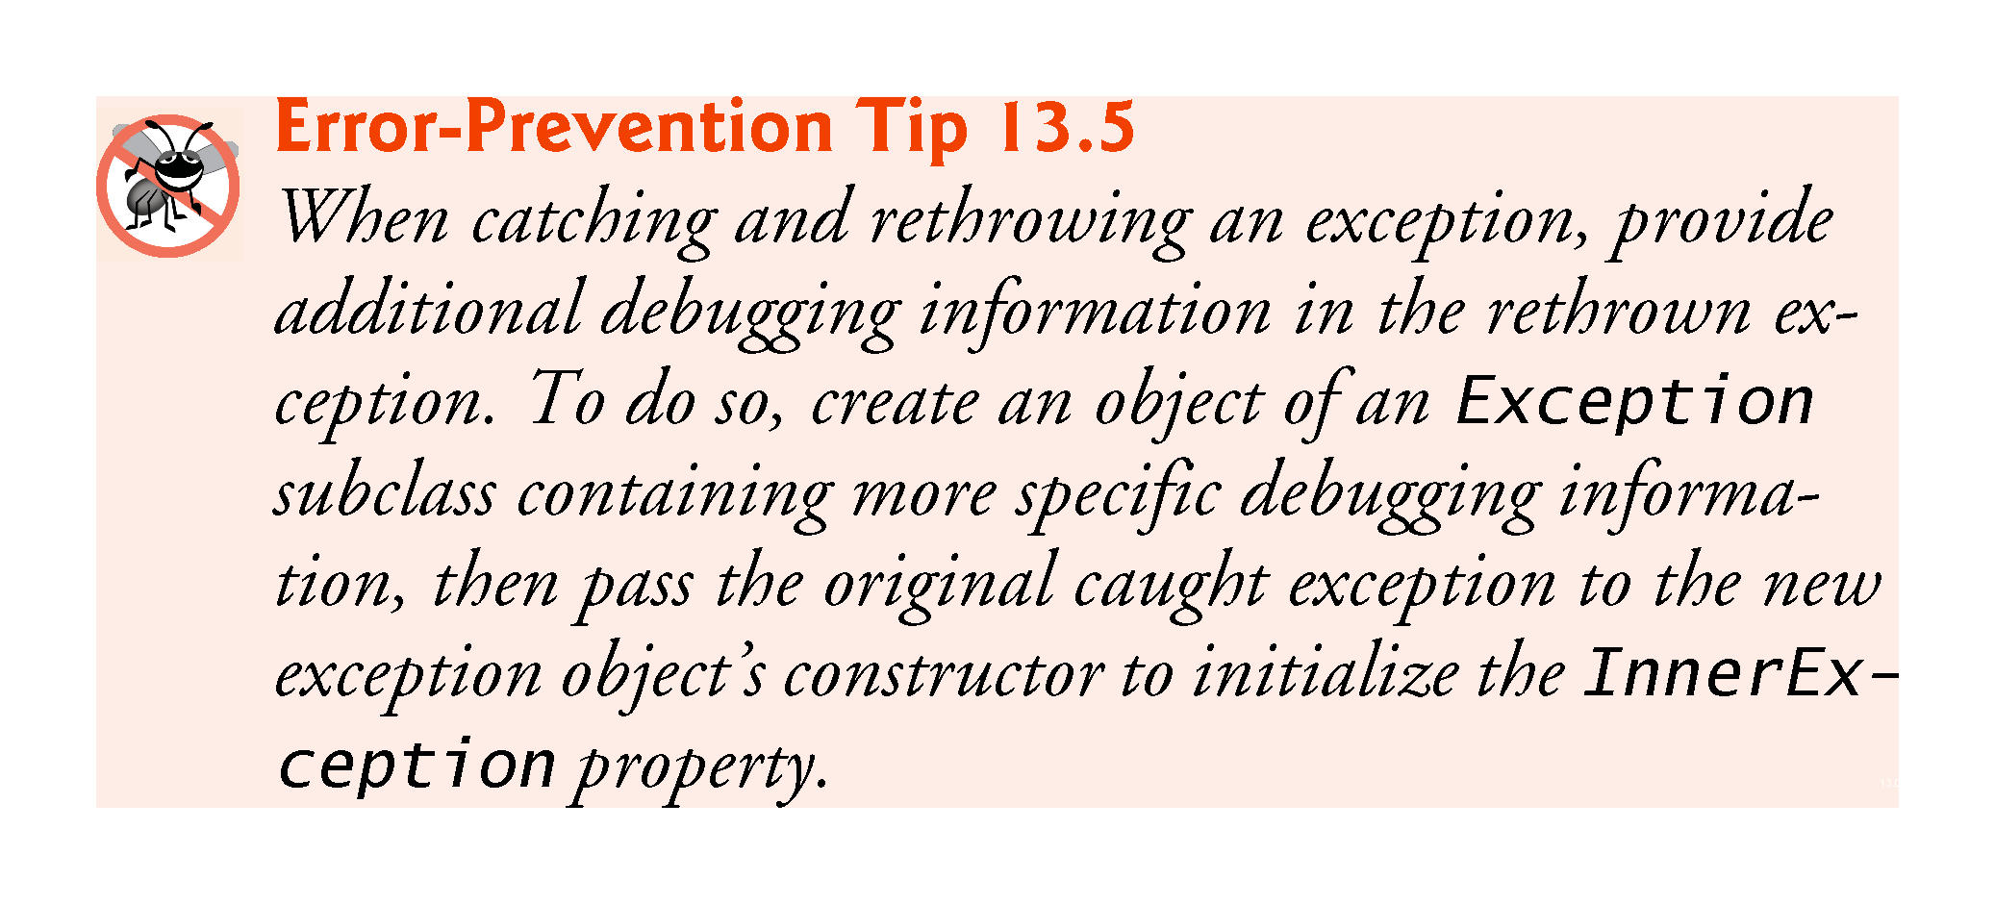

Slide 74
13.8 User-Defined Exception Classes?ignore
In some cases, you might create exception classes specific to the problems that occur in your programs.
User-defined exception classes should derive directly or indirectly from class Exception.
Exceptions should be documented so that other developers will know how to handle them.

Slide 75
13.8 User-Defined Exception Classes (Cont.)
Class NegativeNumberException
Figures 13.6–13.7 demonstrate a user-defined exception class. User-defined exceptions should define three constructors:
a parameterless constructor
a constructor that receives a string argument (the error message)
a constructor that receives a string argument and an Exception argument (the error message and the inner exception object)

Slide 76
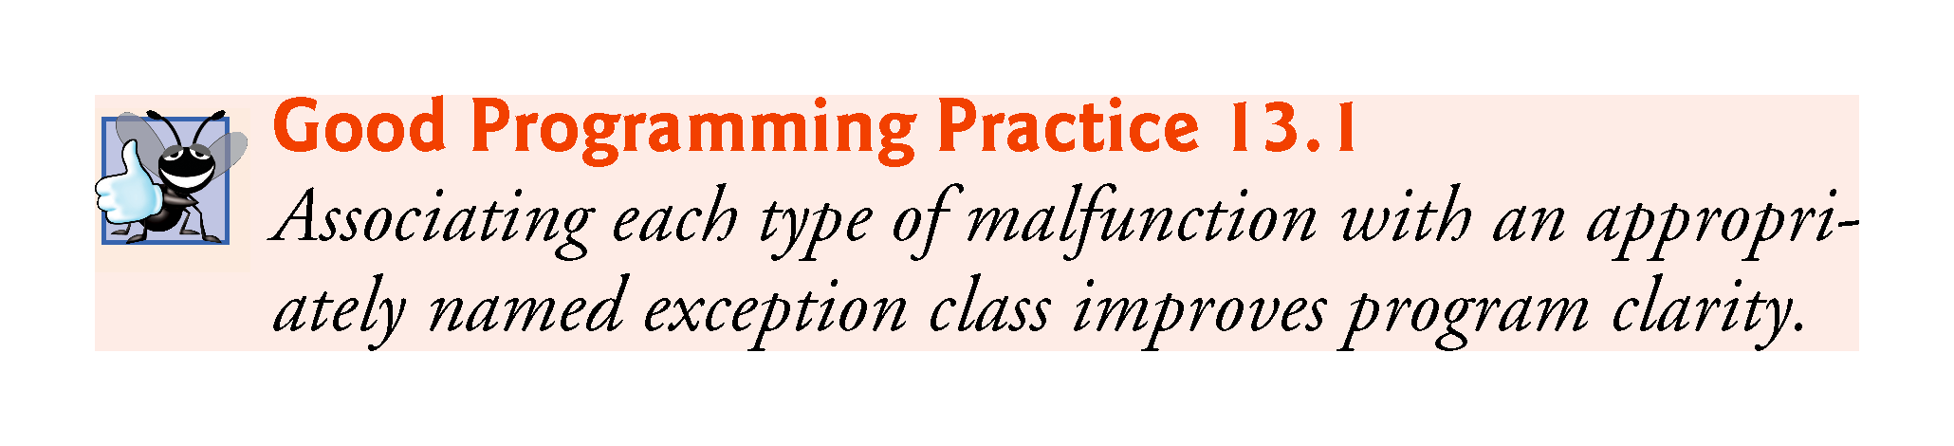

Slide 77
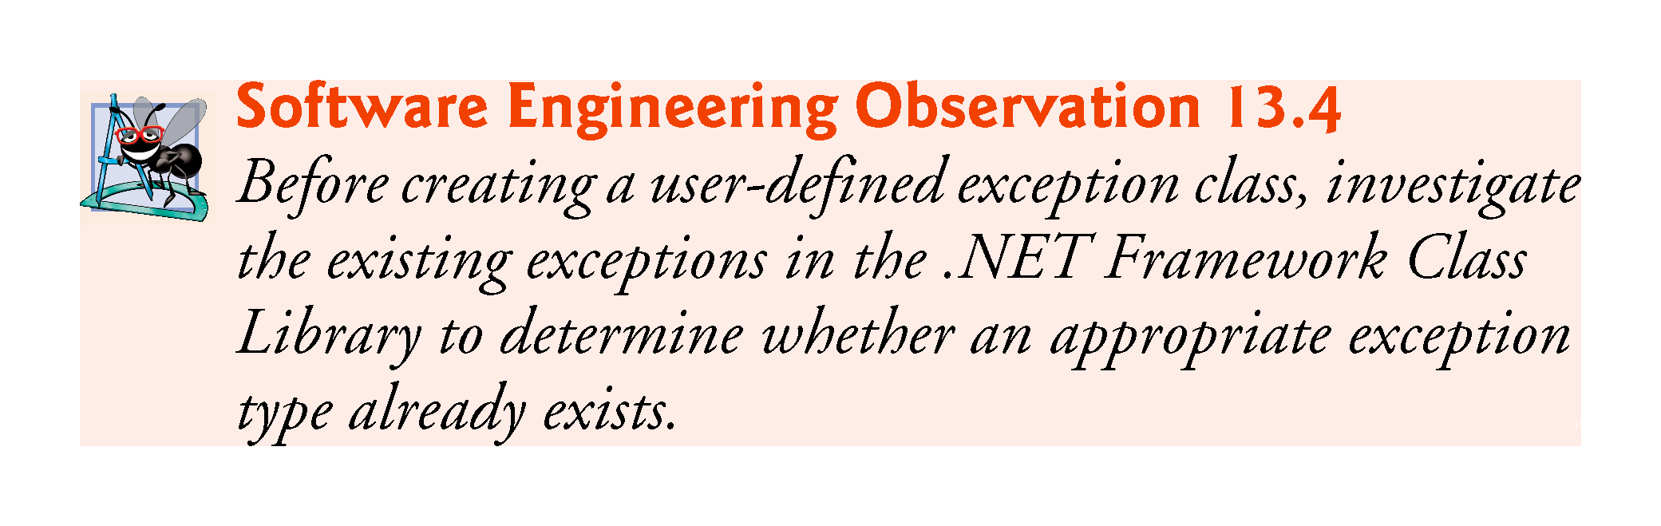

Slide 78
13.8 User-Defined Exception Classes (Cont.)
NegativeNumberException (Fig. 13.6) represents exceptions that occur when a program performs an illegal operation on a negative number, such as attempting to calculate its square root.
Class SquareRootTest (Fig. 13.7) demonstrates our user-defined exception class.

Slide 79
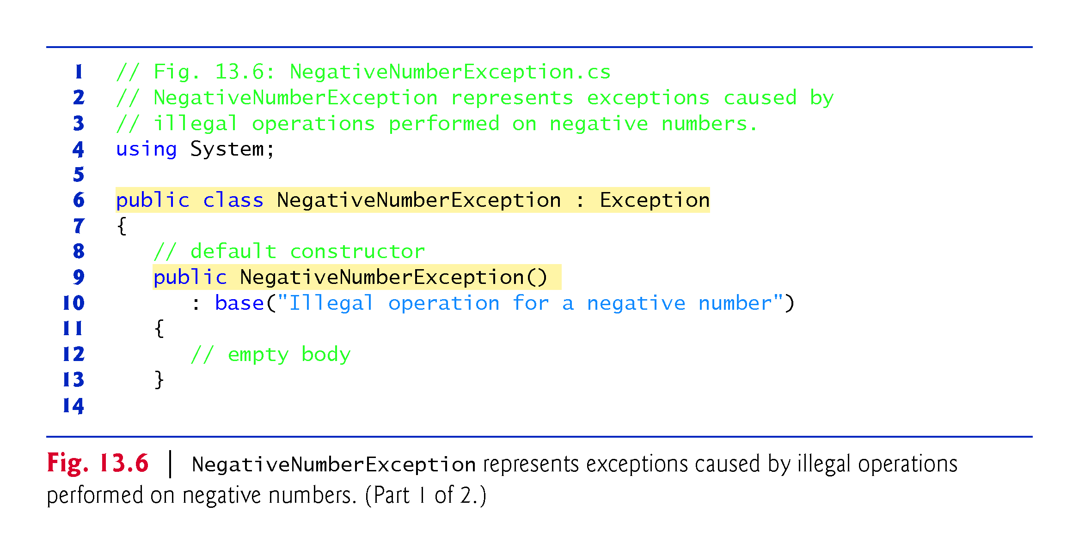

Slide 80
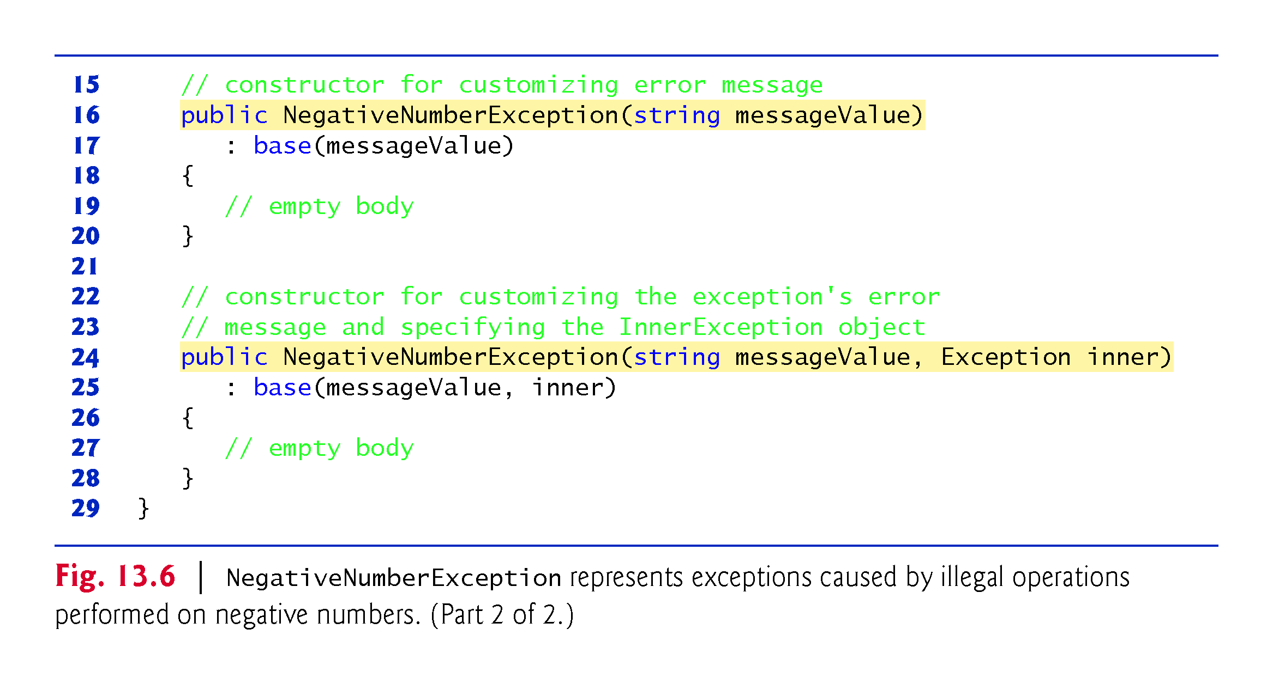

Slide 81
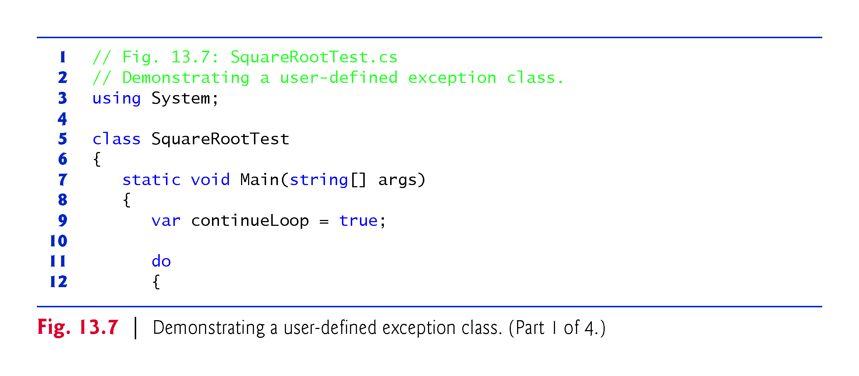

Slide 82
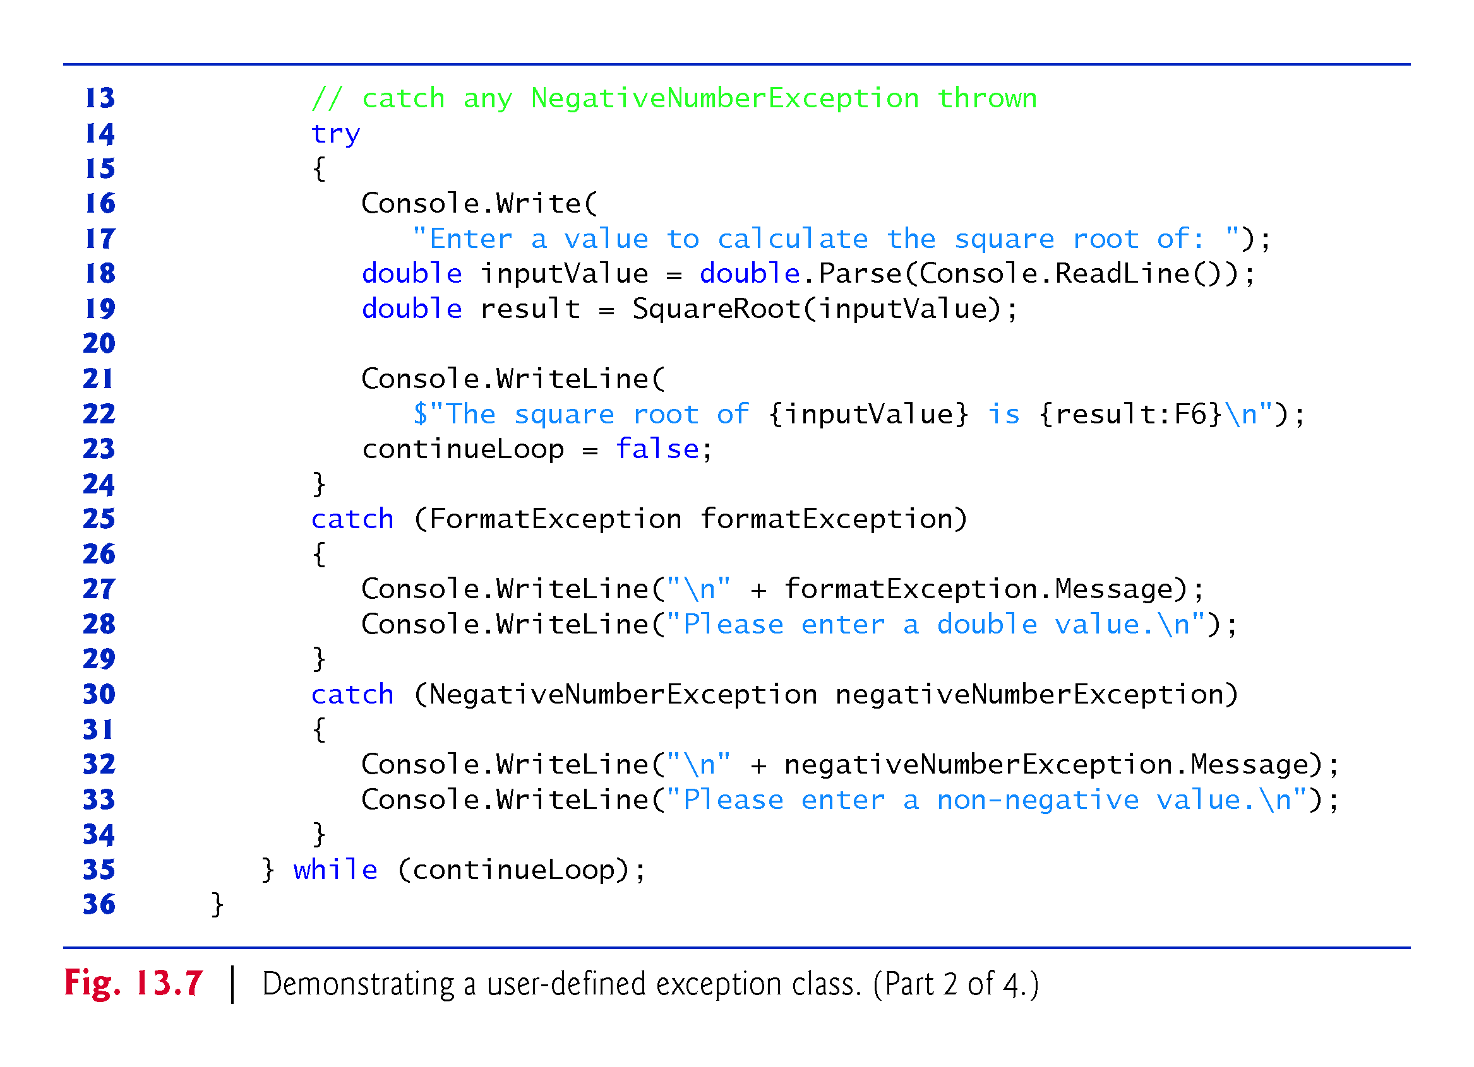

Slide 83
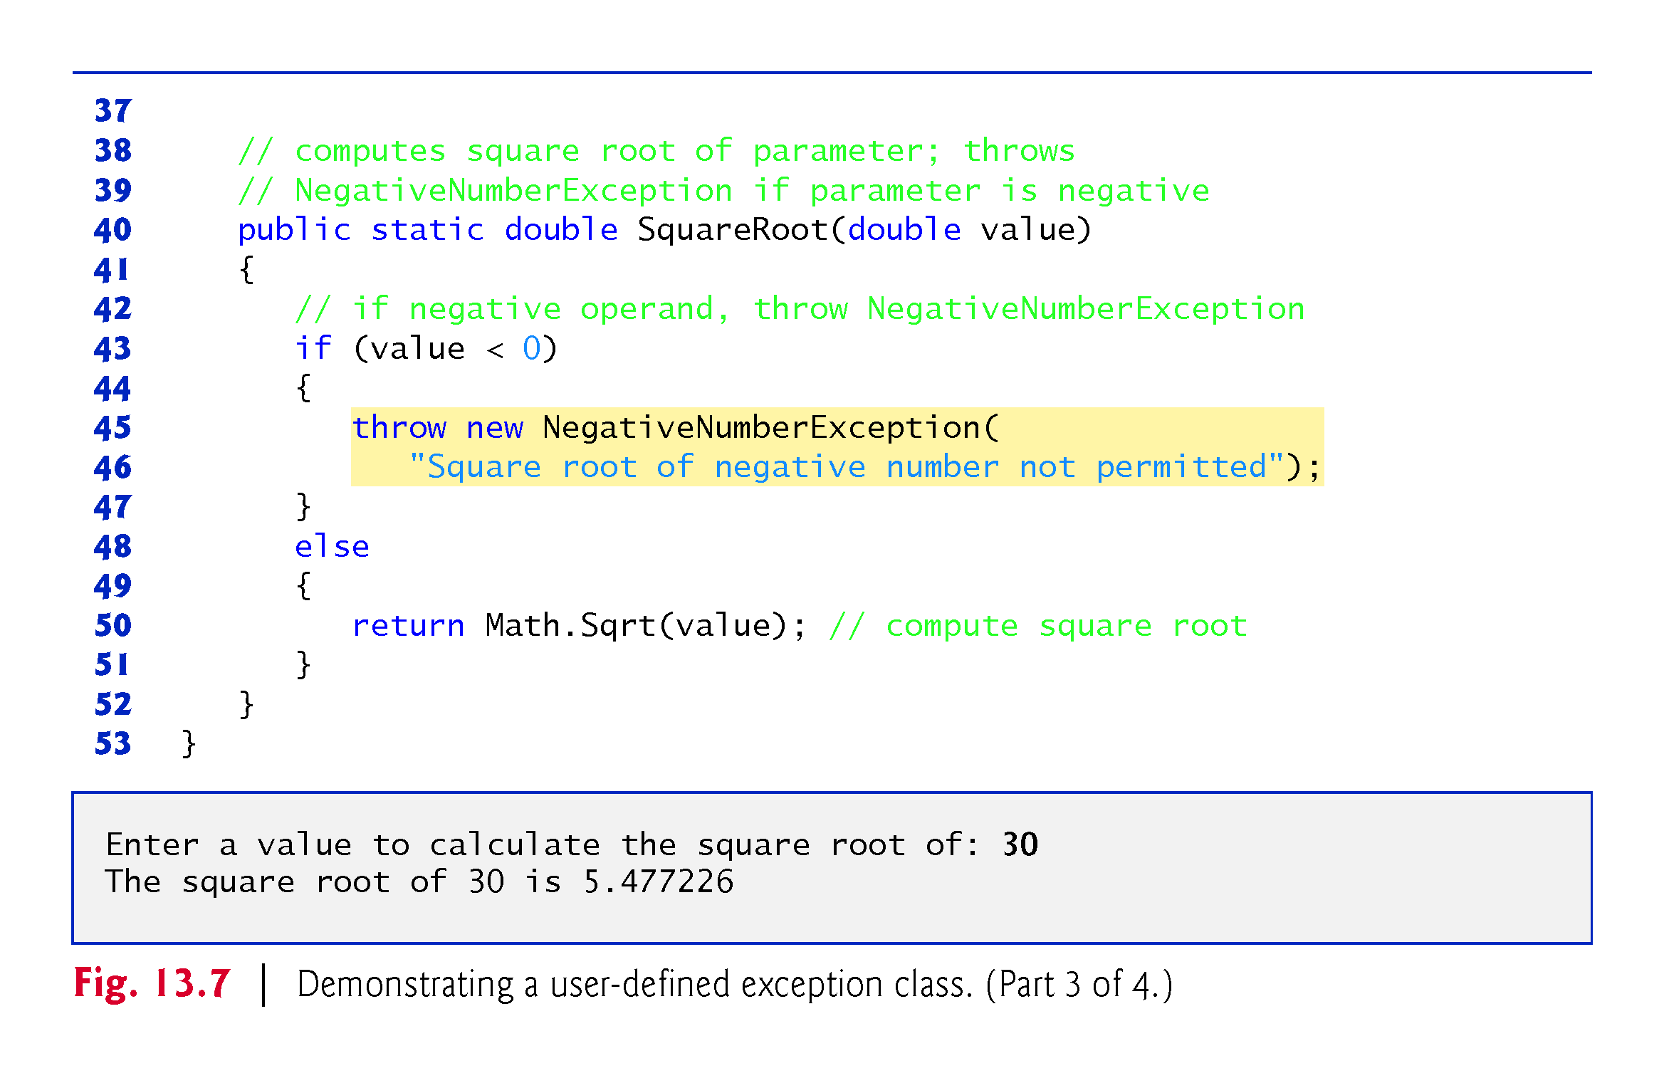

Slide 84
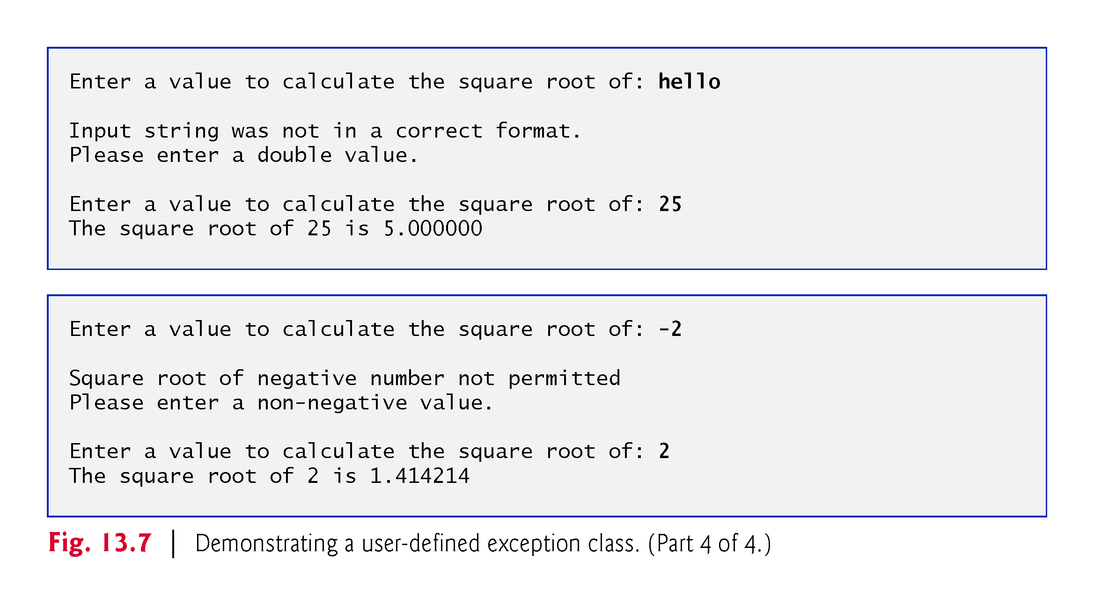

Slide 85
13.9 Checking for null References; Introducing C# 6’s ?. Operator
Checking whether a reference is null before using it to call a method or access a property avoids NullReferenceExceptions.

Slide 86

P
!!!

Slide 87
13.9.1 Null-Conditional Operator (?.) p
C# 6’s new null-conditional operator (?.) provides an elegant way to check for null.
The following statement calls Dispose only if exampleObject is not null
exampleObject?.Dispose();
This eliminates the need to wrap the statement in and if statement that checks exampleObject to see if it’s null
If exampleObject != null;
exampleObject.Dispose();
Else
;
!!!

Slide 88
13.9.2 Revisiting Operators is and as
Downcasting with operator is can cause InvalidCastExceptions.
You can avoid the InvalidCastException by using the as operator:
var employee = currentEmployee as BasePlusCommissionEmployee;
If currentEmployee is a BasePlusCommissionEmployee, employee is assigned the BasePlusCommissionEmployee; otherwise, it’s assigned null.
employee could be null, so you must check before using it.
For example, to give the BasePlusCommissionEmployee a 10% raise, we could use the following statement, which accesses and modifies the BaseSalary property only if employee is not null
employee?.BaseSalary *= 1.10M;

Slide 89
13.9.3 Nullable Types?ignore
Suppose you’d like to capture the value of employee?.BaseSalary
decimal salary = employee?.BaseSalary;
This statement actually results in a compilation error indicating that you cannot implicitly convert type decimal? to type decimal. ???
Normally a value-type variable cannot be assigned null.
Because the employee reference might be null, the expression returns a nullable type—a value type that also can be null.
You specify a nullable type by following a value type’s name with a question mark (?)—so decimal? represents a nullable decimal.
decimal? salary = employee?.BaseSalary;
indicates that salary either will be null or the employee’s BaseSalary.

Slide 90
13.9.3 Nullable Types ?ignore
Nullable types have the following capabilities:
The GetValueOrDefault method checks whether a nullable-type variable contains a value. If so, the method returns that value; otherwise, it returns the value type’s default value.
An overload of this method receives one argument that enables you to specify a custom default value.
The HasValue property returns true if a nullable-type variable contains a value; otherwise, it returns false.
The Value property returns the nullable-type variable’s underlying value or throws an InvalidOperationException if the underlying value is null.
Variables of nullable types also may be used as the left operand of the null-conditional operator (?.) or the null coalescing operator (??).

Slide 91


Slide 92
13.9.4 Null Coalescing Operator (??) ?ignore
C# also offers the null coalescing operator (??) for working with values that can be null.
The operator has two operands. If the left operand is not null, the entire ?? expression evaluates to the left operand’s value; otherwise, it evaluates to the right operand’s value.
decimal salary = employee?.BaseSalary ?? 0M;
if employee is not null, salary is assigned the employee’s BaseSalary; otherwise, salary is assigned 0M.
The preceding statement is equivalent to
decimal salary = (employee?.BaseSalary).GetValueOrDefault();

Slide 93
13.9.4 Null Coalescing Operator (??) ?ignore
More elegant and more compact than writing the following equivalent code, which must explicitly test for null:
decimal salary = 0M; if (employee != null) { salary = employee.BaseSalary }

Slide 94
13.10 Exception Filters and the C# 6 when Clause ?ignore
Prior to C# 6, you could catch an exception based only on its type.
C# 6 introduces exception filters that enable you to catch an exception based on a catch’s exeption type and a condition that’s specified with a when clause, as in
catch(ExceptionType name) when(condition)
You also can specify an exception filter for a general catch clause that does not provide an exception type. This allows you to catch an exception based only on a condition, as in
catch when(condition)
The exception is caught only if the when clause’s condition is true
A typical use of an exception filter is to determine whether a property of an exception object has a specific value.

Slide 95


